Slide 1
Solutions to Pay for the High Cost of Long-term Care
Applying Colorado Long‑Term Care Programs in Rural Communities
Presented by :
Kim Searles, (CSA)®️ Certified Senior Advisor

Slide 2

The Rural Problem: Why Funding Clarity Matters
Rural clients often need home care first, not facility care
Many believe:
They must spend everything down
They make “too much” to qualify
When funding is unclear:
Care is delayed
Discharges are unsafe
Families decline services

Slide 3
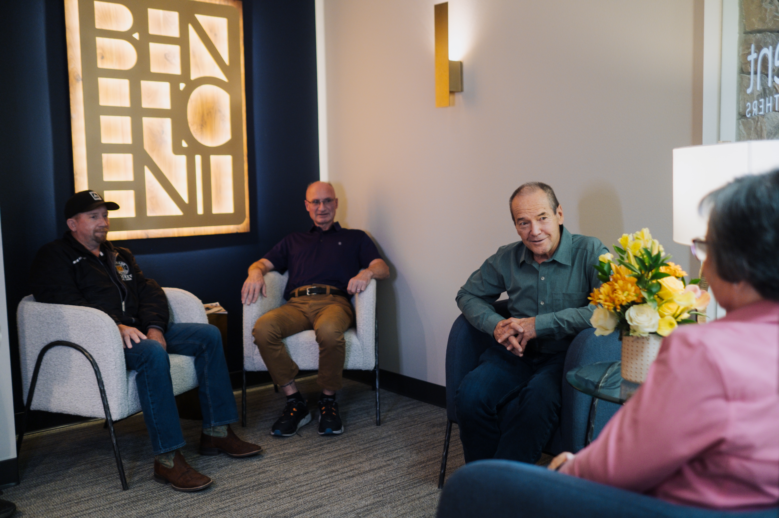
What Actually Pays for Long‑Term Care
Medicare ≠ long‑term care
Long-term Care Medicaid + VA Aid & Attendance are care funding programs
Particularly critical when:
Home care agencies are limited
Family caregivers and friends are the primary workforce

Slide 4

What a Certified Medicaid Planners (CMP) Does
CMPs help clients:
Understand eligibility
• Navigate excess income/assets
• Coordinate Long-term Care Medicaid + VA Aid & Attendance
DHS = eligibility determination
CMP = planning, preparation, coordination

Slide 5
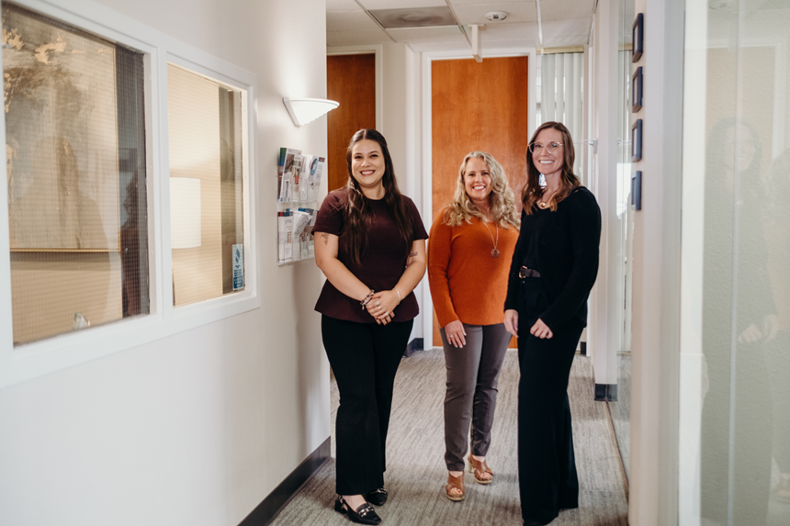
Colorado-Specific Solution: CFC Community First Choice
Effective July 1, 2025
Supports staying at home.
Covers up to 16 hrs/day per caregiver.
Family member, chosen caregiver or a Non-Medicaid Home Care Agency can be paid.

Slide 6
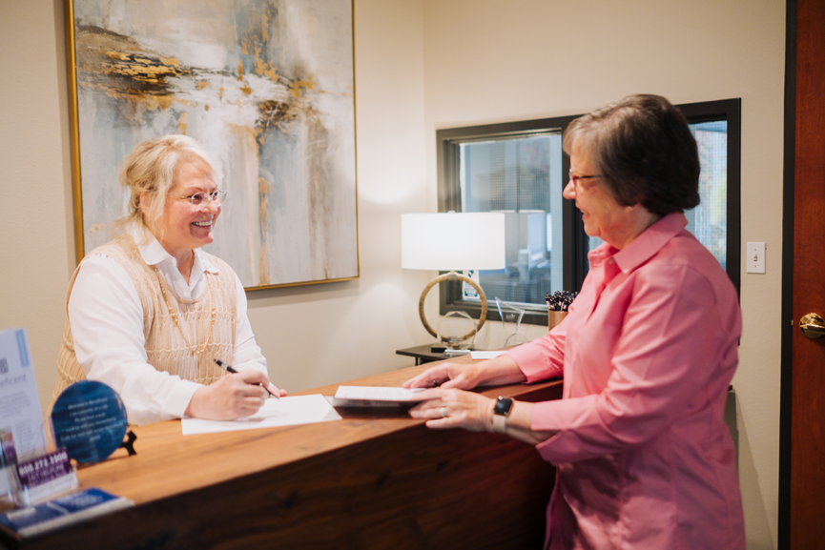
Eligibility Basics
Age/disability
Financial limits
Functional need (ADLs)
Income limits vary by region

Slide 7
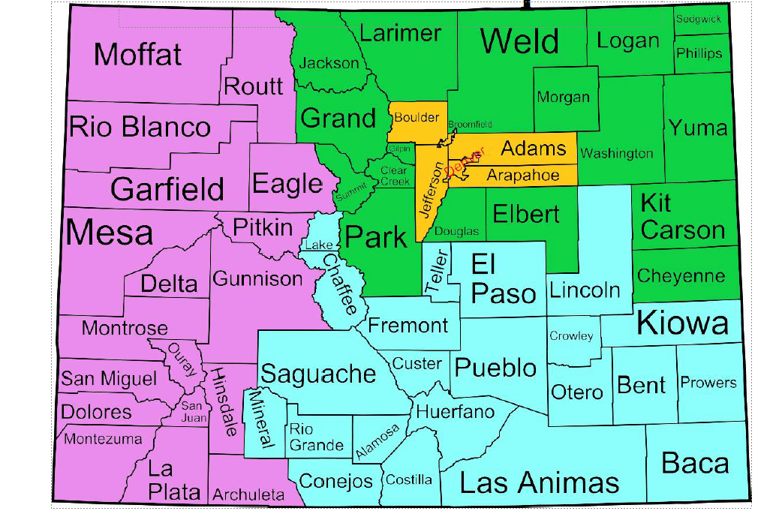
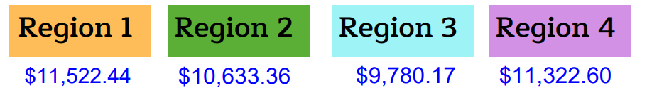
2026 Monthly Income Limit Cap
The different income limits are based on the REGIONS.

Slide 8
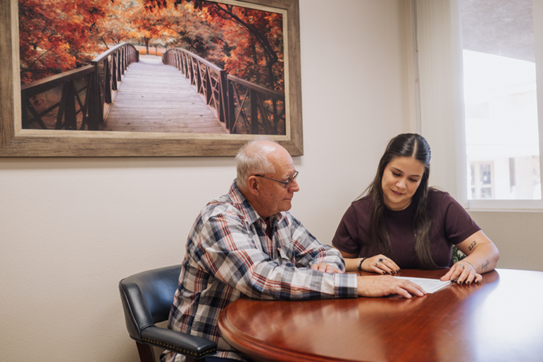
When to Refer + Next Steps
Refer when a rural client:
Needs ongoing care beyond Medicare
Is worried about cost or eligibility
Needs to remain at home safely

Slide 9

NEXT STEP
Have clients Call (719.645.8350)
Have clients Call Beneficent directly then they can mention your organization as their referral source.
Or use the Refer Button on our website www.DoingGoodForOthers.com
to submit client and your details — just be sure the client is expecting our call.

Slide 10
QUESTIONS?

Slide 11
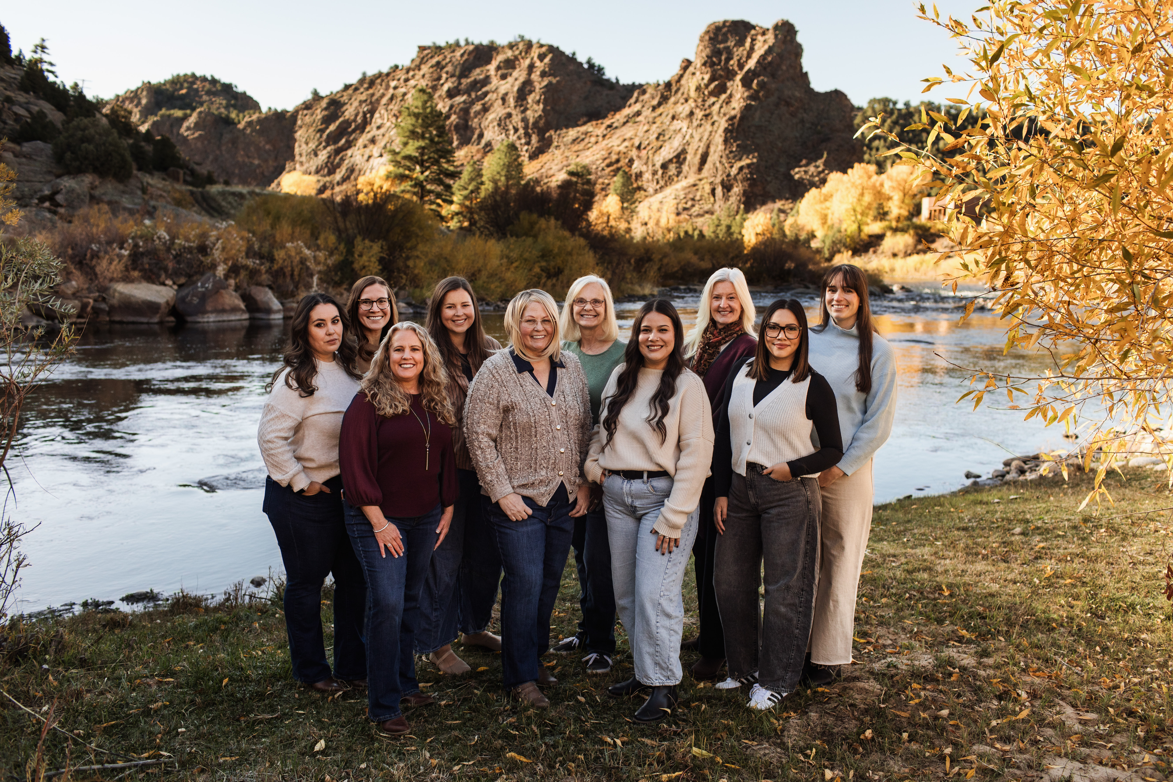
Beneficent Serves - The Whole State of Colorado
719.645.8350
www.doinggoodforothers.com
info@doinggoodforothers.com
665 Southpointe Court Suite #100, Colorado Springs, CO 80906
Schedule a FREE 1-hour Q&A at: https://www.doinggoodforothers.com/schedule-a-free-consultation
Notes:
Instructional meetings are available and can only find out about them because you are on this zoom meeting. We do not post this information on our website….

