Slide 1

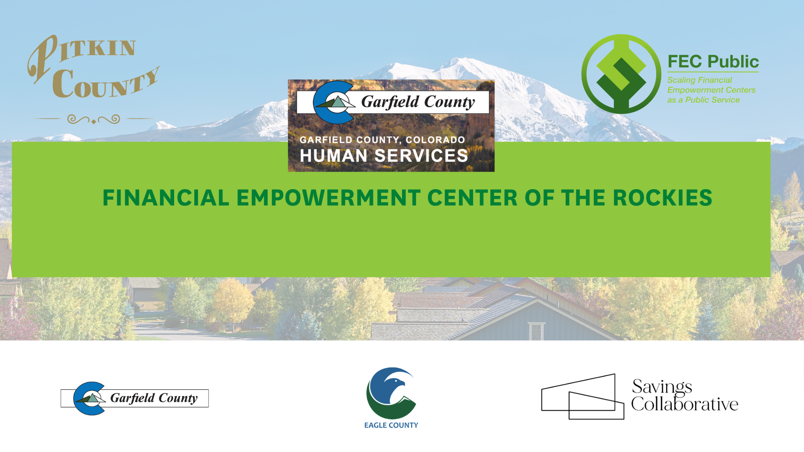

Slide 2
Quick Reminder: Who We Are
We opened our doors in March 2025. Here's what we do:
The FEC of the Rockies provides free, professional, one-on-one financial counseling to all residents ages 18+ in Pitkin, Garfield, and Eagle counties.
40+
FECs nationally
(we are the only rural one)
We are the first tri-county, rural Financial Empowerment Center in the country. We are part of a national network of 37 FECs, supported by local county governments and the CFE Fund. The Savings Collaborative is our financial counseling provider.
3
counties served
(Pitkin, Garfield, Eagle)
We help people with: credit building, debt reduction, budgeting, savings, safe banking, and legacy planning. Bilingual. Confidential. Always free.
FREE
to every client,
every time

Slide 3

Our Impact
$50K
$120K+
Savings Increased
Debt Reduced
People are no longer one emergency away from crisis. A car repair, medical bill, or rent gap no longer immediately turns into more debt.
People are finally breathing again. Lower monthly payments, fewer collections calls, and less daily stress.
Every number represents a real person who sat down, faced their situation, and started moving forward.

Slide 4



What the Work Actually Looks Like
How We Deliver
What We Deliver Most
75–80%
Phone
Credit report review
70%+
Removes transportation barriers — clients call from home
Budget & expense tracking
60%
15–20%
In-Person
Debt management strategies
50%
At libraries, partner sites, and community locations
Debt program referrals (TCA, etc.)
30–40%
5–10%
Video
Savings strategies & account setup
30%
For clients who prefer face-to-face without travel
Legacy planning prep
10–15%
Average session: 55–70 minutes | First session: ~70 minutes
% of sessions that include this service | Based on actual session data

Slide 5
Real Wins From Real Clients
These are not hypothetical outcomes. They happened in our three counties this past year.
First Credit Ever Established
$183K Recovered After a Scam
Car Paid Off, Legacy Planned at 80
A client came to us with no credit history at all — invisible to the financial system. They now have an established credit profile for the first time in their life.
A client was victimized by a fraudulent investment scheme. Working with her counselor over multiple sessions, she recovered stolen funds and paid off major debts.
One of our oldest clients paid off her vehicle, then reviewed her title, deed, and will with her counselor. Her son knows where everything is now.
$660 Monthly Deficit Eliminated
From No Bank Account to Savings Goals
Debt, Credit, Savings, Legacy — All in One
A client was spending $660 more than she earned every month. Together we tracked expenses, cut non-essentials, and brought the budget back to balance.
A client opened a safe bank account for the first time, then set up savings goals and automated deposits — building a financial foundation from scratch.
One client achieved outcomes across five categories in a single engagement: reduced debt, improved credit, opened banking, built savings, and protected assets through legacy planning.

Slide 6


A Real Client Story
I’ll never forget our first meeting- I started crying because I felt suffocated with anxiety and stress.
My financial counselor has taken the time to understand my situation, my goals and explains everything so clearly, and provides guidance that makes me feel confident in my financial decisions.
Now, I feel some sense of hope that I will figure it out and live financially stress free again one day.

Slide 7

When Should You Refer? Just Connect Them to Us.
When a client says or shows:
The Warm Handoff
"I don't know where my money is going"
This is not something extra. This supports the work you are already doing.
No budget, no financial awareness
Struggling to follow through on a plan
1
You Identify
Financial stress is often the hidden barrier
You see a client who could benefit and email us their name and number.
Finances are a barrier but not your focus
2
We Call & Schedule
They need professional financial support — that's us
We reach out directly and set up a session — phone, video, or in-person.
Dealing with debt, collections, or scams
We help them navigate and recover
We Follow Up
3
Approaching retirement with no plan
We keep them engaged over multiple sessions and share progress with your team.
We help with budgeting, savings, and legacy prep
85–90% of scheduled sessions are completed. Warm handoffs reduce drop-off after first contact.
You don't have to solve the financial piece. You just connect them to us.

Slide 8
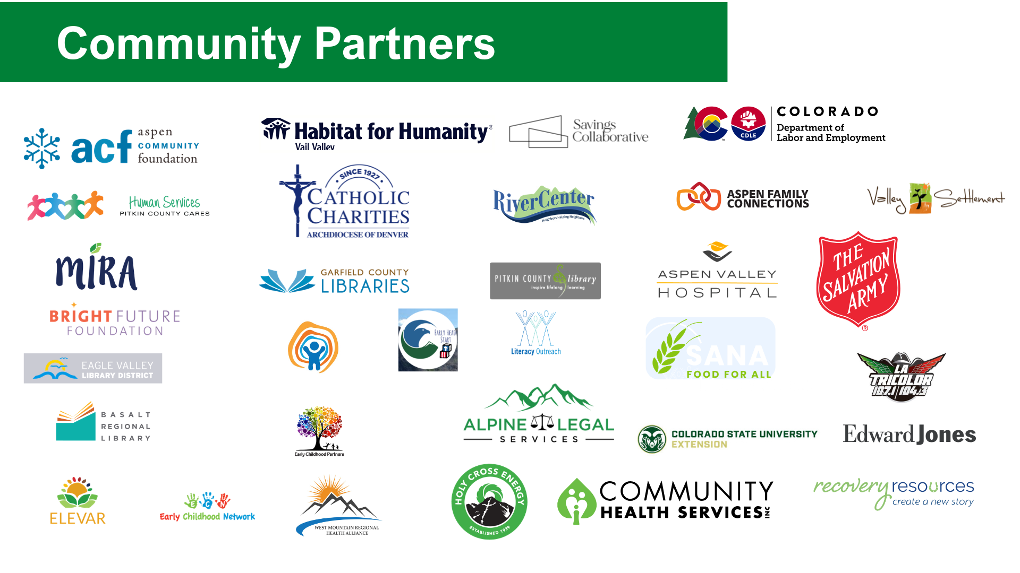

Slide 9

You already do the hard work of supporting clients every day.
We help make the financial piece more manageable so your work can go further.
Refer a client today:
coaching@savingscollaborative.org
fecrockies.org | 970-704-6736 | @fecrockies
Contact: iliana@savingscollaborative.org

