Slide 1

Medicaid Participatory Action Incubator (M-PAI) Launch
Gaining user experience and understanding on Medicaid Community Engagement (Work) Requirements
Notes:
Lead Facilitator
1 minute
NOTES:
Start by introducing yourself
Due to federally mandated work requirements, volunteer organizations will be asked to track or verify the participation of your volunteers
This session is an opportunity to…
Learn what you’re already doing and how it's working
Talk honestly about what is realistic for technology for your organization and the people you serve
Learn what challenges could arise with the upcoming work requirements related to tech
We want to help you understand the changes that are coming, as well as understand what is most needed to create a system that meets the needs of organizations like yours as well as medicaid members.
Your input will help shape solutions that are practical, equitable, and aligned with how community organizations actually operate.

Slide 2

POWERED BY
THE COLORADO HEALTH FOUNDATION
Our mission is to improve the health of Coloradans.
We believe that health and well-being can be in reach for everyone. So, every day, we collaborate with organizations and communities across the state to break down the many systemic inequities that stand in the way of health. When every Coloradan has the power to be healthy, our entire state is stronger.
Notes:
The California Health Care Foundation is dedicated to advancing meaningful, measurable improvements in the way the health care delivery system provides care to the people of California, particularly those with low incomes and those whose needs are not well served by the status quo. We work to ensure that people have access to the care they need, when they need it, at a price they can afford.

Slide 3
Purpose of today
Provide information about the Prime Health Medicaid Participatory Action Incubator (M-PAI)
Understand what we are doing now
Grasp what to expect in the future
General timelines for what is next and when we will see things continue to roll out
How YOU can support and engage

Slide 4
What are community engagement/work requirements?
https://hcpf.colorado.gov/impact

Slide 5

Community engagement/work requirements
The following are qualifying activities for the work requirements:
80 hours per month of approved activities (or combination of)
Working
Participating in a work program
Volunteering
Going to school
Earning at least $580 from paid work
Showing documentation that they meet an exemption and do not need to meet the work requirement

Slide 6
How to Get Engaged
Bookmark the resource center and member work requirements page
Send all questions, comments, and feedback to hcpf_HR1@state.co.us.
Stay tuned for future webinars, all opportunities will be shared in the At a Glance newsletter
Share our current and future Member Messages from HCPF Executive Director Bimestefer with colleagues and member
Thank you for your partnership and engagement as we work together to implement H.R. 1 and focus on our North Star.
Notes:
As you see, se are federally mandated to achieve a great amount in a very short period of time, and much of what H.R. 1 requires is not up for negotiation.
We know we are stronger together! We want your input, and are identifying areas where stakeholders can influence decisions
If you have questions or comments after this session, please visit our webpages that have detailed information and reach out to our HR1 team. Engagement opportunities are being announced through the At a Glance newsletter so make sure you are signed up.
Thank you, and we look forward to connecting in the future!

Slide 7
Purpose of Medicaid Participatory Action Incubator
Aligning with HCPF’s North Star
Through: Bringing communities together to identify best practices, define technology requirements, and vet solutions that actually work for users.
Notes:
Prime Health
1 minute

Slide 8
Theory of Change
IF those impacted and who need to report data related to the Medicaid Work Requirements are meaningfully engaged as co-designers of technology
THEN we can ideally create a system that reflects:
Community concerns and Constraints
Workflows and equity considerations
With the overall goal being to:
Prevent unnecessary coverage loss
Reduce administrative burden for Members,
Improve data accuracy and interoperability

Slide 9
Who we are engaging
Medicaid Members
Validators
Nonprofits, churches and other volunteer organizations
Education Institutions
Job Training Organizations
Businesses and Employers
Data Users and Verifiers
Counties
State and Regional Accountable Entities
Healthcare Organizations
Communicators and Supporters
CBOs, advocacy organizations and partners
Technologists
Companies, innovators, new, and existing technology
Technologists and Innovators
Supporters and Communicators
Data Users and Verifiers
Validators
Medicaid Members
Notes:
Prime Health
1 minute

Slide 10

Collaboration with The Center to Advance Consumer Partnership
PrimeHealth is partnering with CACP to ensure our efforts are coordinated, co-informed and mutually reinforcing.
CACP is supporting the development of a member-centered communication plan and toolkit to ensure members receive clear, consistent, and timely information about HR 1 changes, what the changes mean for them, what they need to do, and where they can turn for help or answers.
Our shared goal is simple; no members should lose coverage or experience confusion because they didn’t understand a change.
CACP is a national organization that partners with people who use Medicaid services and community-based supports to reveal what’s working organizations translate insight into action that improved access, equity, experience, and outcomes.
Notes:
CACP is helping HCPF to strengthen how Medicaid members receive information from the Medicaid ecosystem. This work will be informed by the feedback from Medicaid members and key organizational partners.

Slide 11
Phases
PHASE 1: DISCOVERY
PHASE 2: CHALLENGE
PHASE 3: VET & VALIDATE
PHASE 4: PILOT
February - May 2026
May - June 2026
June - July 2026
August - December 2026
Documented best practices and requirements from users
Companies selected for validation based on user requirements
Final set of vetted and validated companies, to pilot
Final list of Prime Health piloted companies
Notes:
Prime Health
1 minute

Slide 12

Workshops of 30 people from each of the following groups
Medicaid Members
Validators
Nonprofits, churches and other volunteer organizations
Education Institutions
Job Training Organizations
Businesses and Employers
Data Users and Verifiers
Counties
State and Regional Accountable Entities
Healthcare Organizations
Communicators and Supporters
CBOs, advocacy organizations and partners
Technologists
Participating as ‘Fish bowl’ where they listen but not contribute
Notes:
Prime Health
1 minute

Slide 13
Output: Document outlining best practices and requirements of the technology from USERS
Includes:
Summary of conversations
Common requirements across users
Unique requirements by user
Non-technology requirements
Alignment of requirements to national standards and/or discussions
Notes:
Prime Health
2 minutes

Slide 14
Technology and System Needs for Community Engagement Requirements
What we will workshop:
Current systems and technology you use to track your volunteer, client, or participant engagement
What is going well and not going well in those systems
What is needed, and should be avoided, in new systems as they are being developed
What we do not workshop:
HR 1 in general
Rules and laws of the work requirements
Clarifying confusion on work requirements
Discussing issues with current Medicaid enrollment systems
Other changes to Medicaid happening at the federal or state level
Solutions to the problems
Notes:
Prime Health
2 minutes
NOTES: Be sure to add, we are going to give an overview of the current situation but these are provided by HCPF and any additional questions or information you need about the specifics of the changing laws should be asked of HCPF, more info on who to ask is at the end of the meeting

Slide 15
Engage tech companies and entrepreneurs, shifting them from listeners to co-designers through a Prime Health Challenge process
Companies apply to the Challenge, the initial application and rubric will be built on user requirements from Discovery Phase
Judges* review applications and score companies based on whether they meet User Requirements
Selected companies move forward to Phase 3
Output: Selected technology solutions that meet user requirements
Judges: Users from Discovery Phase, Entrepreneurs and partners from Innovation and tech ecosystem
Notes:
Like round 2 of the challenge
Step 1 - longer versions of speed networking

Slide 16
Pair tech companies and entrepreneurs with judges to directly vet and provide feedback from users to national tech leaders
One-on-one time with judges to review solutions and test them
Companies will apply to a second application that focuses on:
What did they update and improve based on judge feedback and
Compliance (state and federal), Security, and Technology requirements
Output: Updated requirements document that includes compliance, security and technology requirements as well as vetted and validated companies who are selected at the end of Phase 3
Notes:
Like round 2 of the challenge
Step 1 - longer versions of speed networking

Slide 17
Selected solutions are piloted with selected host organizations from user groups identified and engaged throughout the process
Specific host organization are selected to pilot selected solutions based on the solutions requirements and whether they meet that users needs
Piloting of solutions takes place between hosts and solutions
Solutions are updated based on feedback from users
Data are collected from piloted solutions to ensure they are meeting state requirements and user requirements
Output: Final list of piloted solutions are presented as Prime Health recommended solutions that include data of how they meet state and user requirements
Notes:
Like round 2 of the challenge
Step 1 - longer versions of speed networking

Slide 18
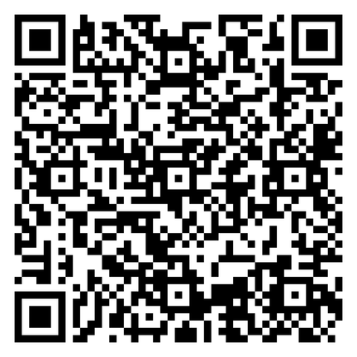
What role can you plan in M-PAI?
Organizational engagement in upcoming Discovery sessions
Counties and RAEs - April 13, 10am-12pm, virtual
Employers and Businesses - April 23rd, 9am-11am Virtual
Higher Education Institutions - April 28th, 2:30pm-4:30pm, virtual
Volunteer Organizations - April 30th, 9am-11am or 1pm-3pm in person in Denver
Supporters (those who support Medicaid members to enroll) - May 6th 10am-12pm, virtual
FQHCs (already full) - April 7th in Colorado Springs
Communicators and Advocates - May 12th, 9am-11am or 1pm-3pm in person in Arvada
Final Event and release of findings - June 4th, 8:30am-12:30pm, location TBA
Already completed: Volunteer organizations (virtual) and Job Training Organizations
Scan this QR code to request to join a session or to serve as a judge!

Slide 19
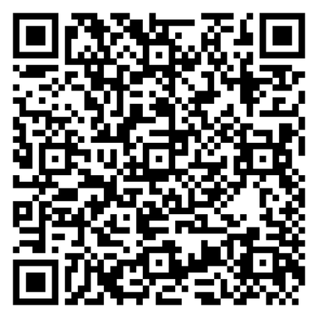
What role can you plan in M-PAI?
Can’t make it to one of the Discovery Sessions?
Complete a survey to provide us with information about current systems and what is needed from future technology.
Consider serving as a judge or host in future phases (complete the form from previous page).

Slide 20
Thank you!
Questions?
Admin@primehealthco.com

