Slide 1

Quarterly Meeting
April 20, 2026

Slide 2
Quarterly Meeting Agenda
11:35a WMRHA Board President Welcome
11:40a WMRHA Presentation
12:15p The Colorado Health Foundation and Colorado Health Institute Presentation
1:00p Partner Presentations

Slide 3

Celebrating more than 10 years of impact!
Notes:
For those of you who were unable to attend our 10 year anniversary, I wanted to share some of the video from our event. It highlights the collaboration and the focus on Advancing Health and Building Hope. We want to continue to work with all of you to make this happen in our region and our communities. I want to share one story that really touched my heart recently, an unhoused person suffering with frost bite and at risk of losing their foot was provided emergency housing withHealth Solutions West, Catholic Charities, Salvation Army, and the Alliance. The person was able to get the wound care needed, and now this person is in a two-year treatment facility. This is what is possible with collaboration.

Slide 4
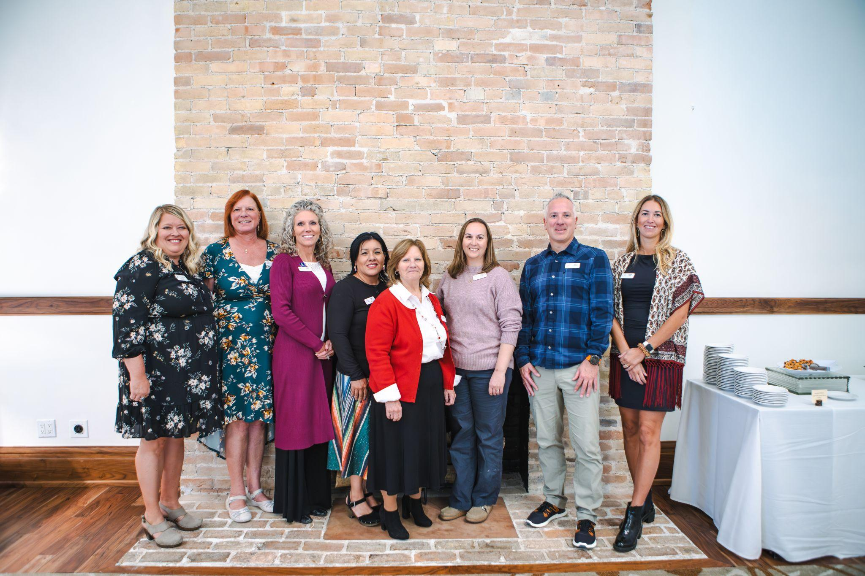
Advancing Health and Building Hope
It all began informally in 2010 with a spark of a hope and dedicated individuals—born from the recognition that prenatal care access gaps in western Eagle County for low-income women demanded a regional solution. What followed was formation of amission to bring together key partners to build a stronger health system across Eagle, Garfield, and Pitkin Counties.
Building Partnerships and Initiatives that Address Real Needs
Innovating Around Social Determinants of Health
Addressing Housing and Homelessness
Growth and Building Sustainability
Notes:
Add photos from the Anniversary Event

Slide 5

Looking Forward
While we’re proud of how far we’ve come, there is more work and some significant challenges ahead. In the coming years, WMRHA will continue to:
Deepen our efforts to ensure health equity and that all people have a voice, representation, and improved outcomes.
Strengthen data systems so we measure what matters and use data to guide action.
Expand capacity for housing support, food security, and access to integrated health.
Ensure that our innovations are sustainable, scalable, and resilient in times of crisis. (economic, public health, or otherwise).

Slide 6

A Heartfelt Thank You
None of this would have been possible without you — our partners, funders, staff, board, volunteers, and the many individuals who trust us with their stories, their hopes, their challenges. Because of you, the spark ignited ten years ago has grown into a beacon of change for the region.
We must continue to collaborate and find creative resource solutions as a community. We invite you to stand with us. We need you as a partner, funder, community member, and advocate. Your commitment will help ensure we Advance Health and Build Hope.
Together we are stronger

Slide 7
$1,494,334 in funding was distributed to agencies in FY 624_525
Resource Directory and Guide Updated 2025 and 2026
Permanent Supportive Housing Project Underway 2025 & 2026
Collaborative
Grants
Theory of Change
Community
Connections
MCFNS
VAEH
WMRHA Board adopts Theory of Change
MCFNS Food Security Gaps Analysis Report Completed 2026

Slide 8
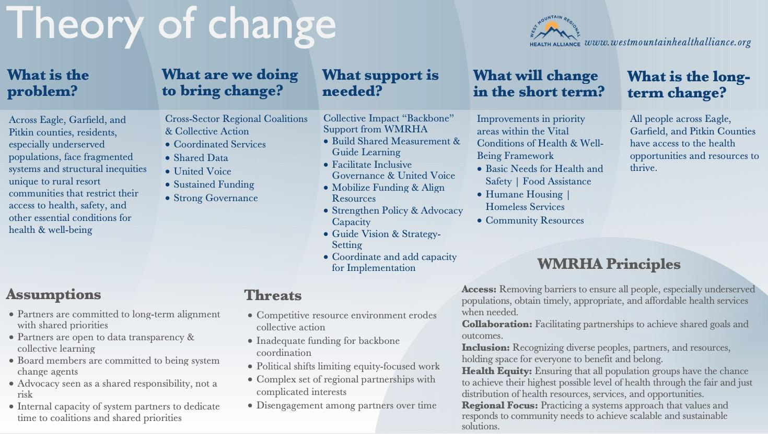

Slide 9
WMRHA Membership: JOIN US!
The WMRHA Board approved implementing membership in WMRHA.
Membership will enhance and expand what WMRHA can offer to partners.
Membership will be based on a sliding fee scale based on budget size.
WMRHA will hold a meeting in May to share specifics and answer follow-up questions.
Why membership now?
Alliance membership increases engagement and sustainability to ensure that WMRHA can continue to offer a high-level of service and support collaboration and expansion of funding to the region.
Notes:
Add key components…poll in Zoom chat?
Focusing on increasing engagements and benefits in the community.

Slide 10
Membership Benefits
Member Benefits
● Inclusion in the WMRHA member directory/partner network (NEW)
● Access to quarterly coalition-wide convenings/meetings.
● Regular e-newsletter/data updates on regional health, housing, and food security.
● Ability to submit organizational updates/needs to the WMRHA network for collaboration or resource-sharing.
● Opportunity to be considered for grants, joint proposals, or shared projects convened by WMRHA (if eligibility criteria met).
● Discounted rates for trainings, capacity-building workshops, data/analytics support, and evaluation frameworks.
● Public acknowledgement or “partner spotlight” on WMRHA website, annual reports to enhance visibility for members.

Slide 11

Potential Future Benefits
Future Benefits
Support (consulting services) for capacity support, surge capacity, or resources
Shared Development Staff Member
Collective Action engagement and training
Collaborative Advocacy and Policy Efforts
Others TBD

Slide 12

Membership Sliding Scale Fees
Tiers (Annual Operating Budget) | Annual Dues to WMRHA
Tier 1 – Budget under $150,000 | $ 150
Tier 2 – Budget $150,000 – $350,000 | $ 325
Tier 3 – Budget $350,001 – $550,000 | $ 650
Tier 4 – Budget $550,001 – $999,999 | $ 925
Tier 5 – Budget $1,000,000 – $3,000,000 | $ 1,225
Tier 6 – Budget $3,000,001 | $ 1,525

Slide 13
MCFNS Gap Analysis

Slide 14
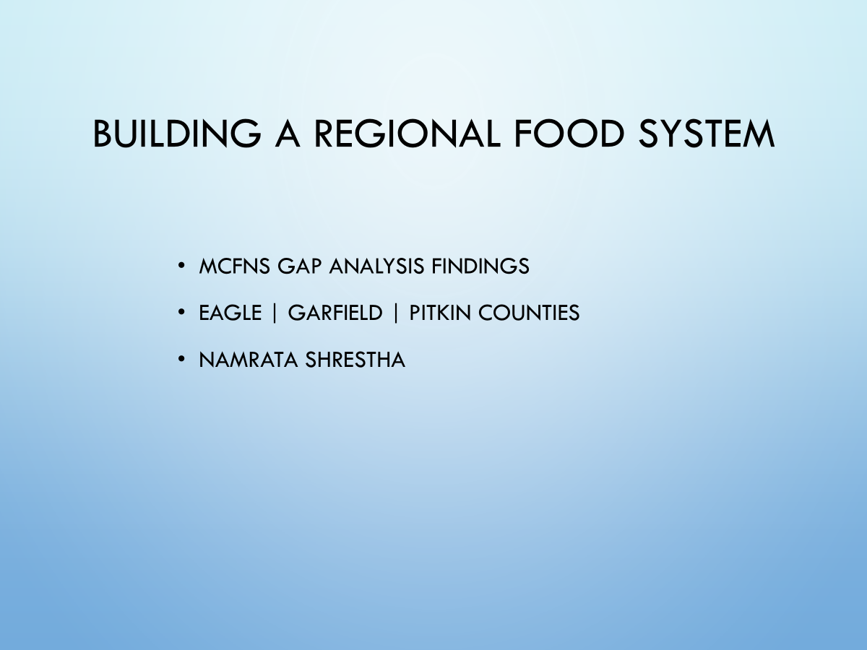

Slide 15
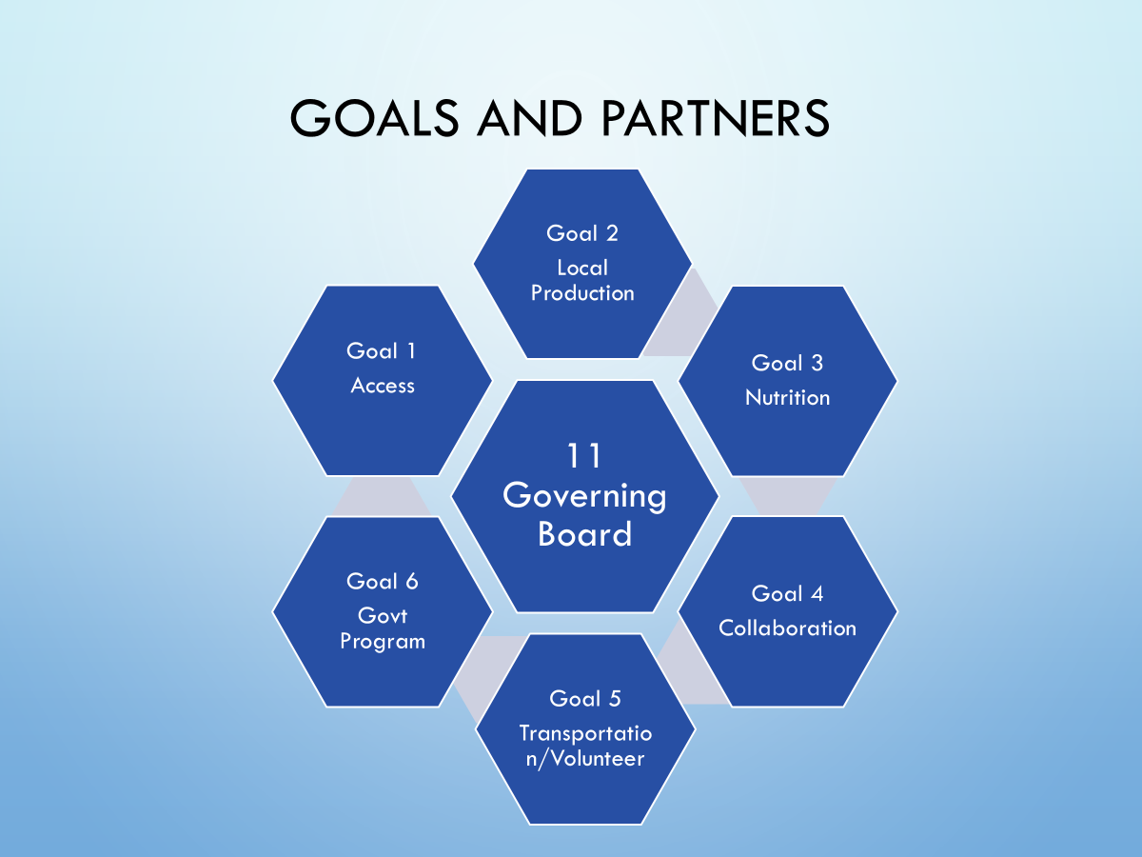

Slide 16
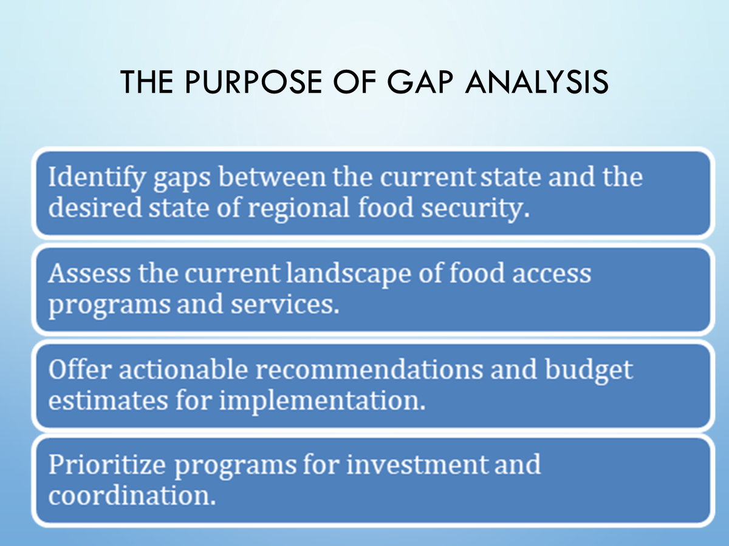

Slide 17
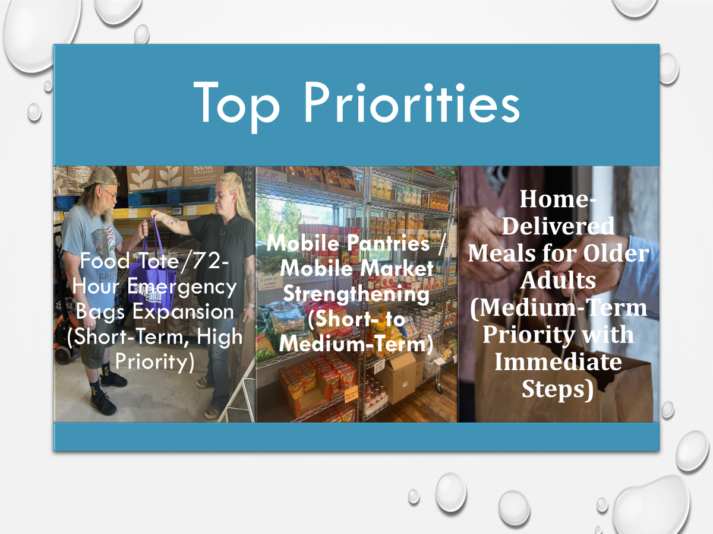

Slide 18
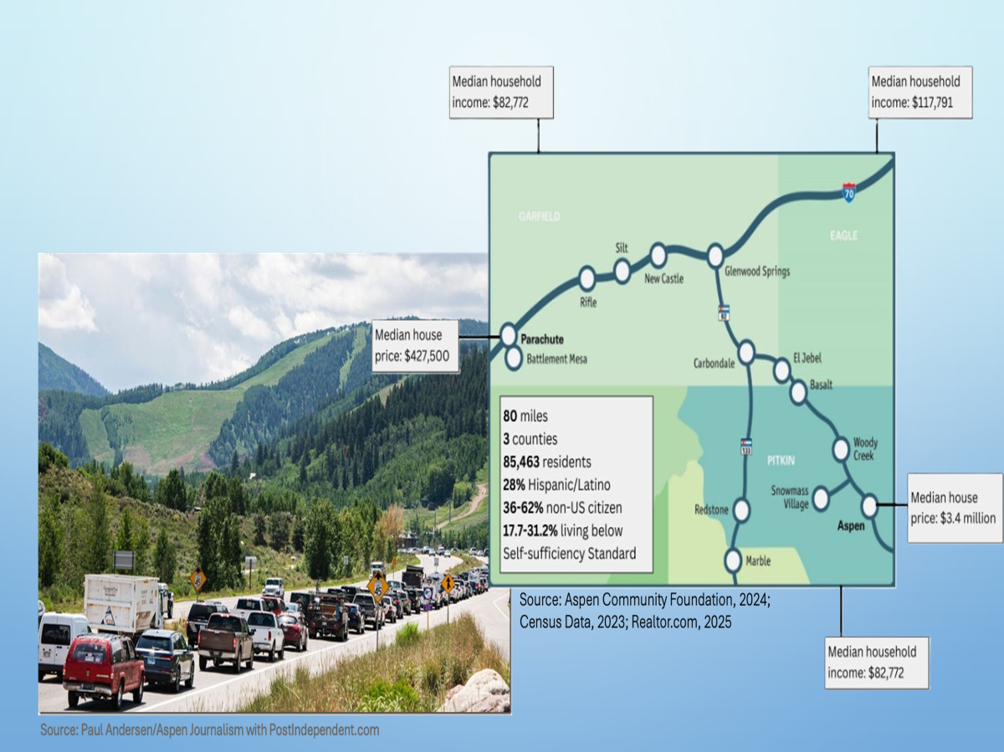

Slide 19
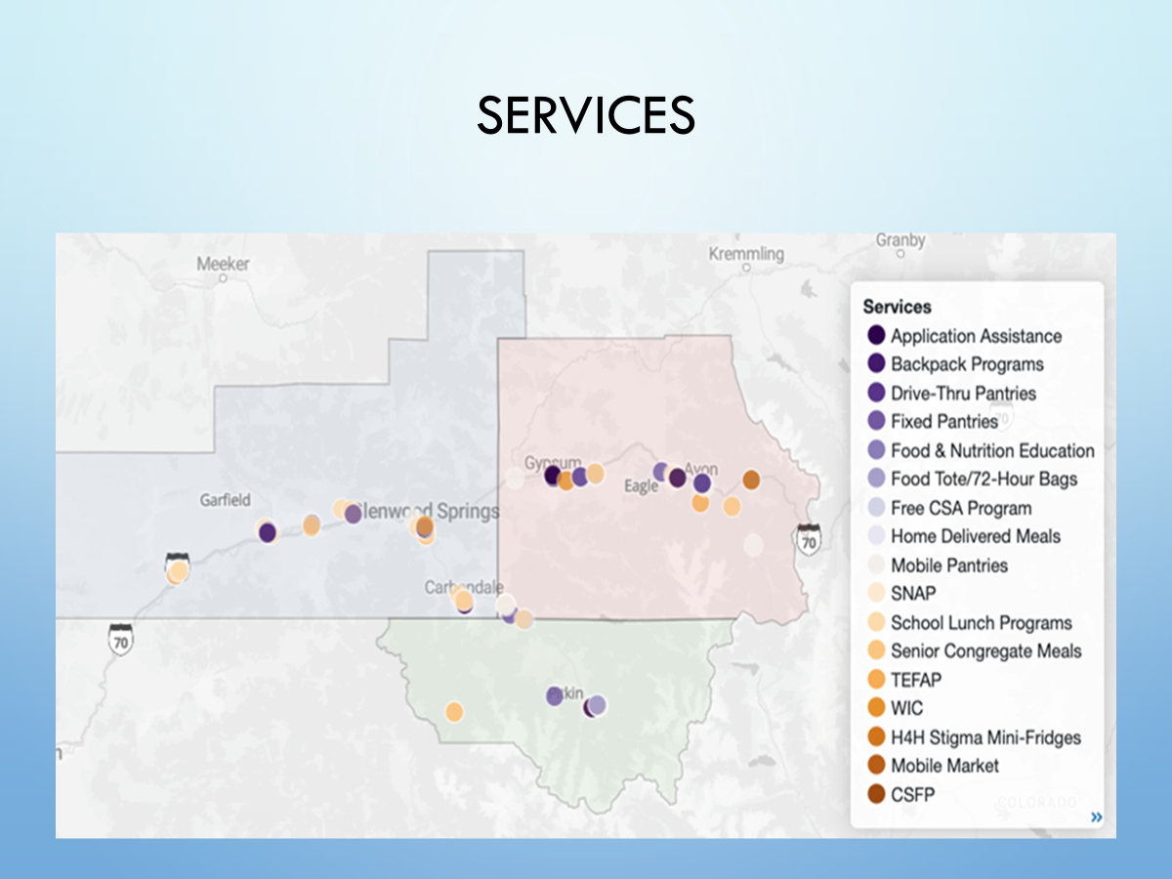

Slide 20
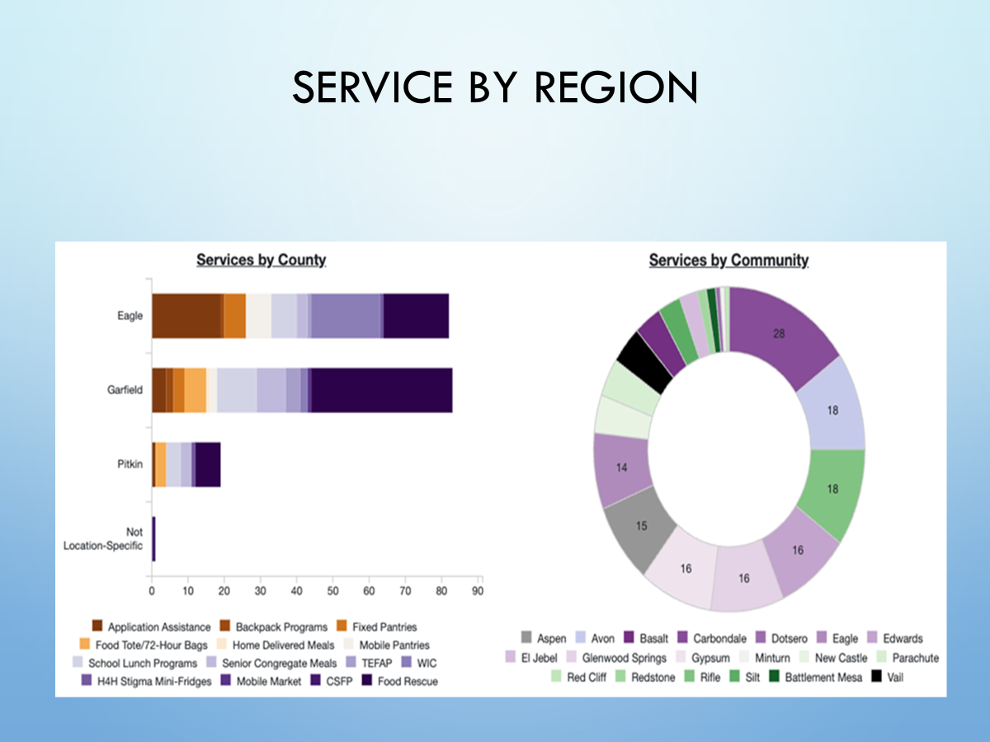

Slide 21
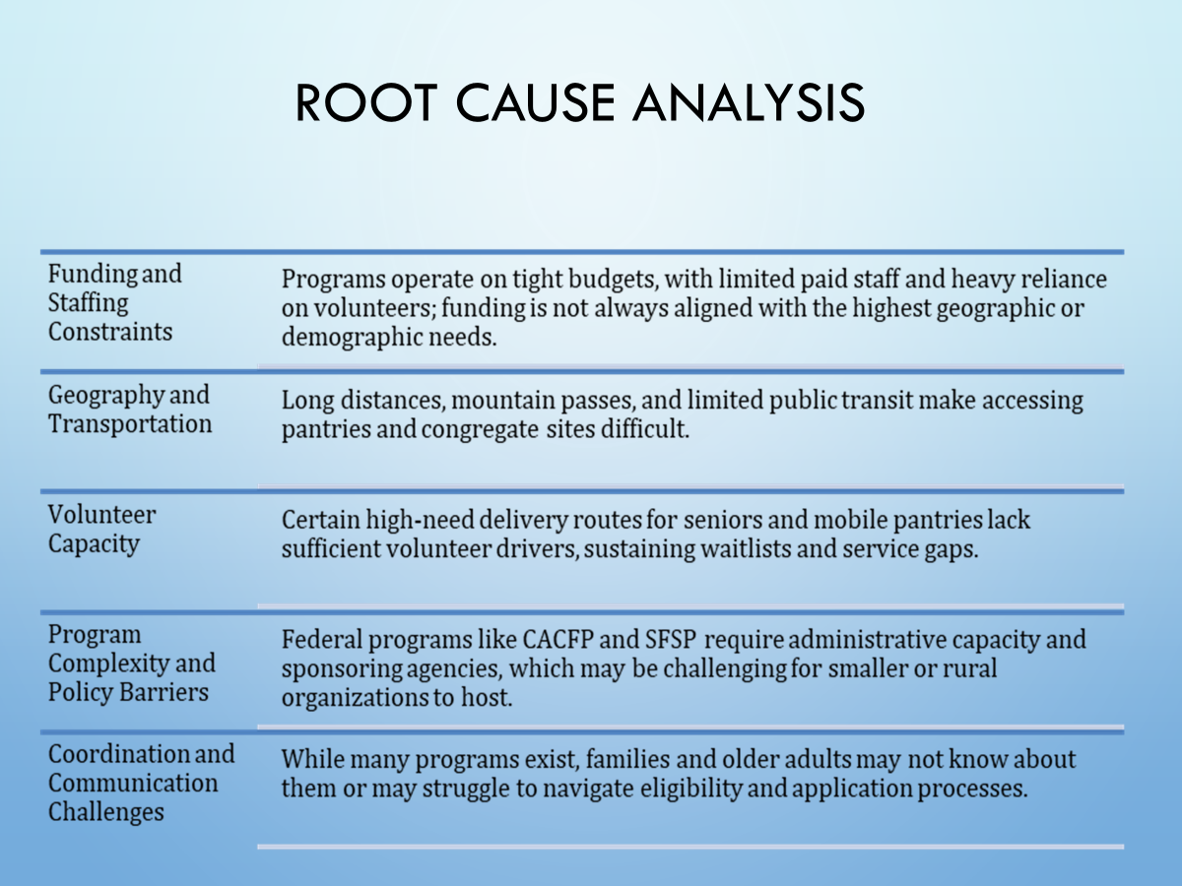

Slide 22
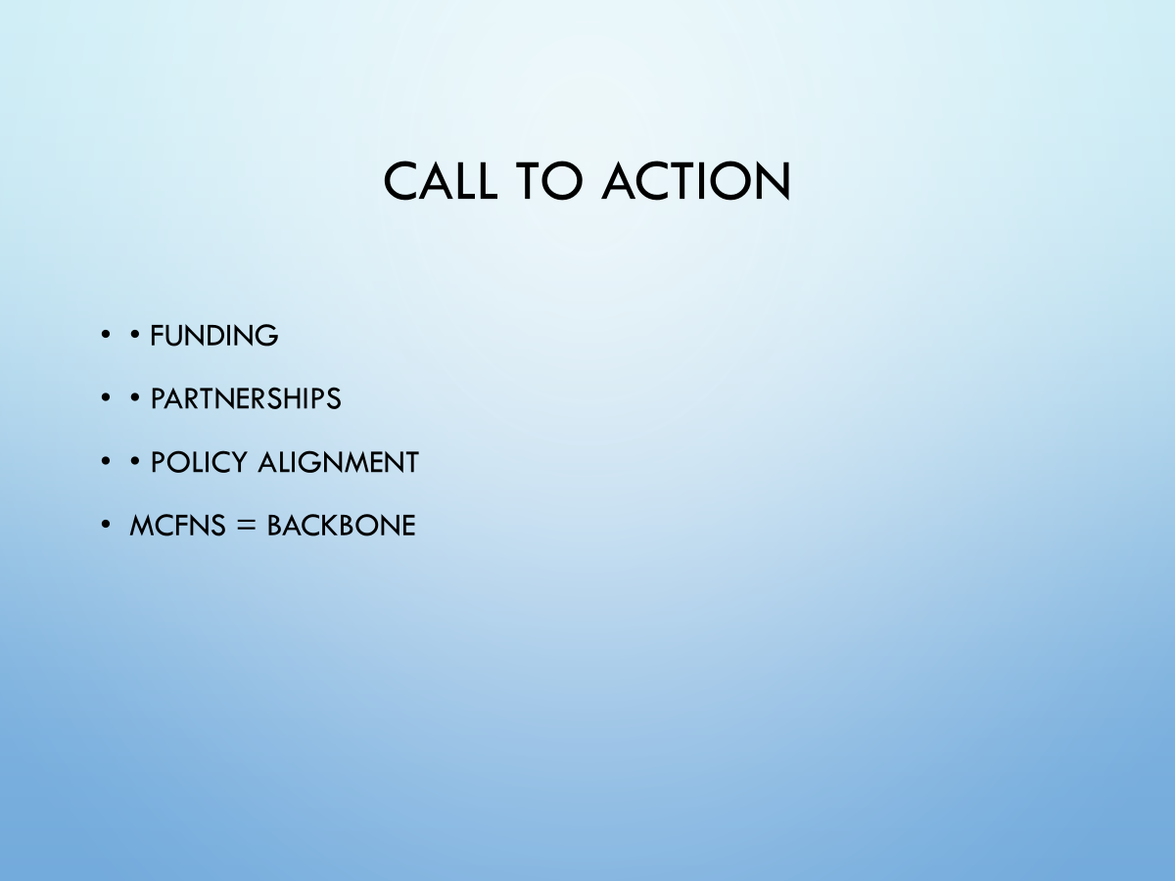

Slide 23
VAEH Impact
Notes:
The Valley Alliance to End Homelessness (VAEH) was formed to address issues related to housing insecurity and the needs of those experiencing homelessness. The VAEH believes a regional continuum of coordinated and accessible resources, guided by a shared housing-first approach, is the foundation for preventing and ending homelessness in Garfield, Pitkin and Eagle counties.
Our aim is that people in the tri-county area have access to safe and sustainable solutions for preventing and ending experiences of homelessness.
All partners are committed to ensuring that homelessness is a rare, brief and one-time experience and that services are accessible, effective, efficient.

Slide 24
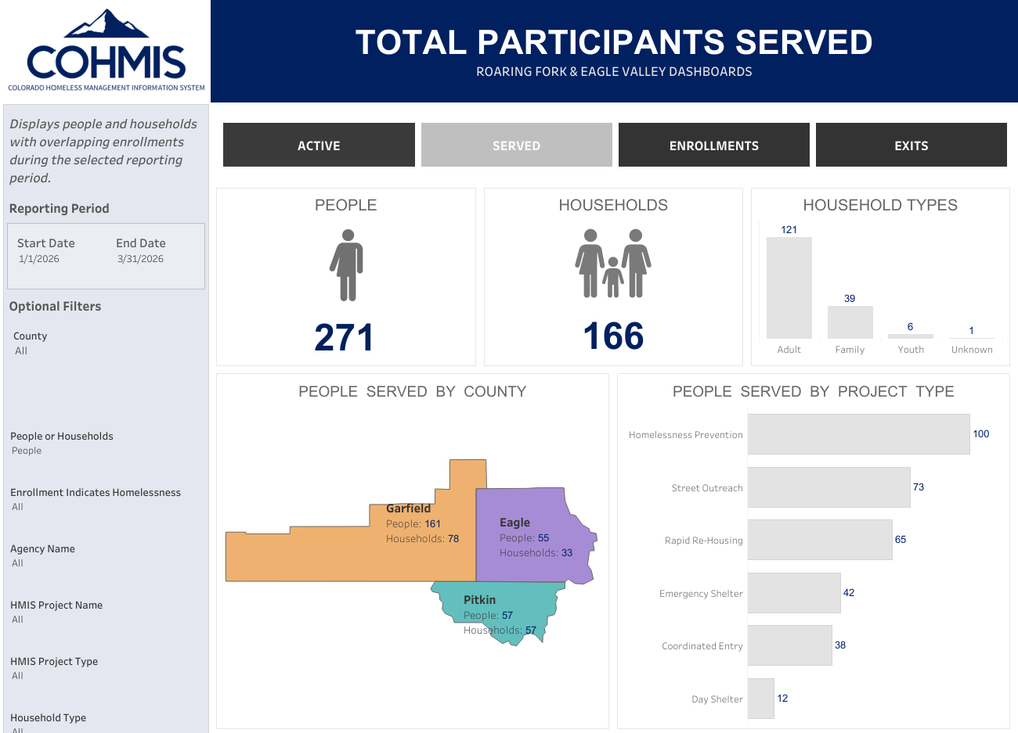
Housing Outcomes
More individuals accessed services this quarter.
Bringing our served from 233 to 271 for individuals, and 155 to 166 for households.
During the first quarter of 2026, 31 individuals across 15 households were exited to Permanent Housing Solutions.
In the previous quarter, 26 individuals and 18 households exited to permanent housing.
Active: 227 people and 133 households.

Slide 25
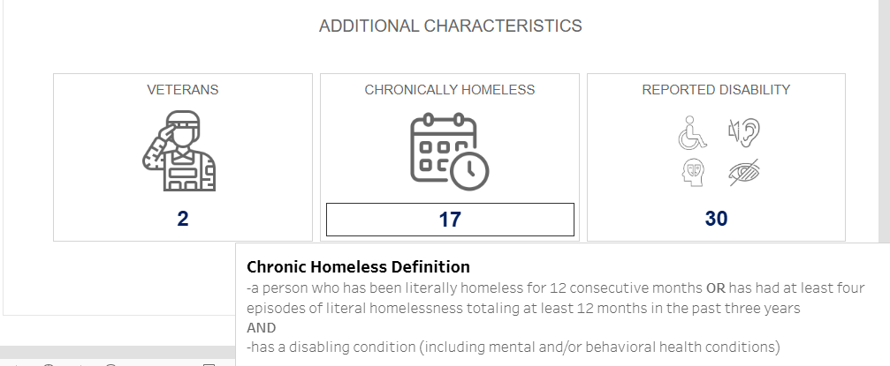
Average Length to Housing and Quality Data
The average time from system entry to housing increased from 87 days to 149 days this quarter.
This was a result of external pressures affecting housing placements.
Data completeness improved.
Missing demographic information improved by 59% in enrollments.
Notes:
Housing placements got impacted through the loss of vouchers, and changes in housing policies, which have created additional barriers to securing units.
Despite this, remember more were exited to positive solutions.
Maintaining and improving data quality standards
This improvement strengthens our ability to understand who we are serving and identify potential disparities in outcomes.
Overall, we are seeing continued engagement with the system and stable housing outcomes. However, housing placement timelines are increasing, reflecting broader housing constraints. Encouragingly, data quality continues to improve, which will allow for stronger system analysis and planning.

Slide 26
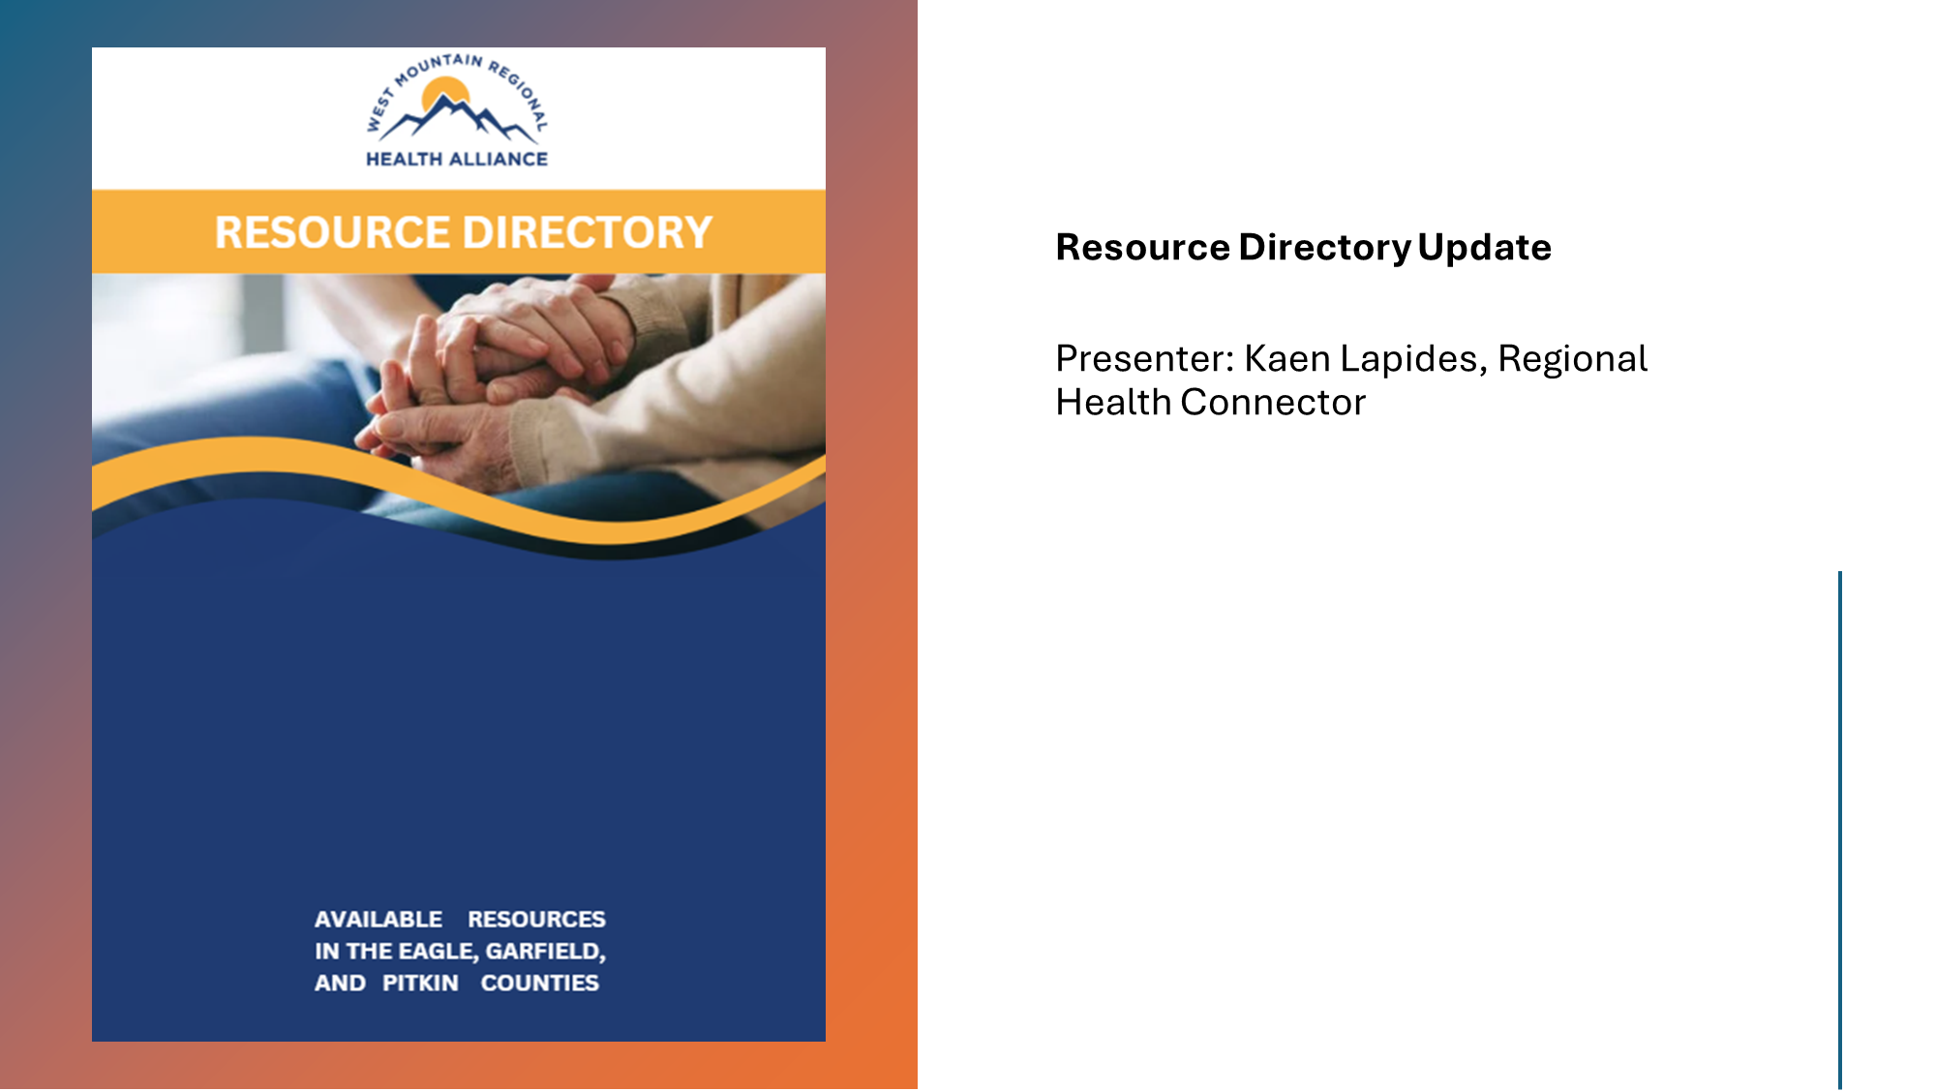
Resource Directory and Guide

Slide 27
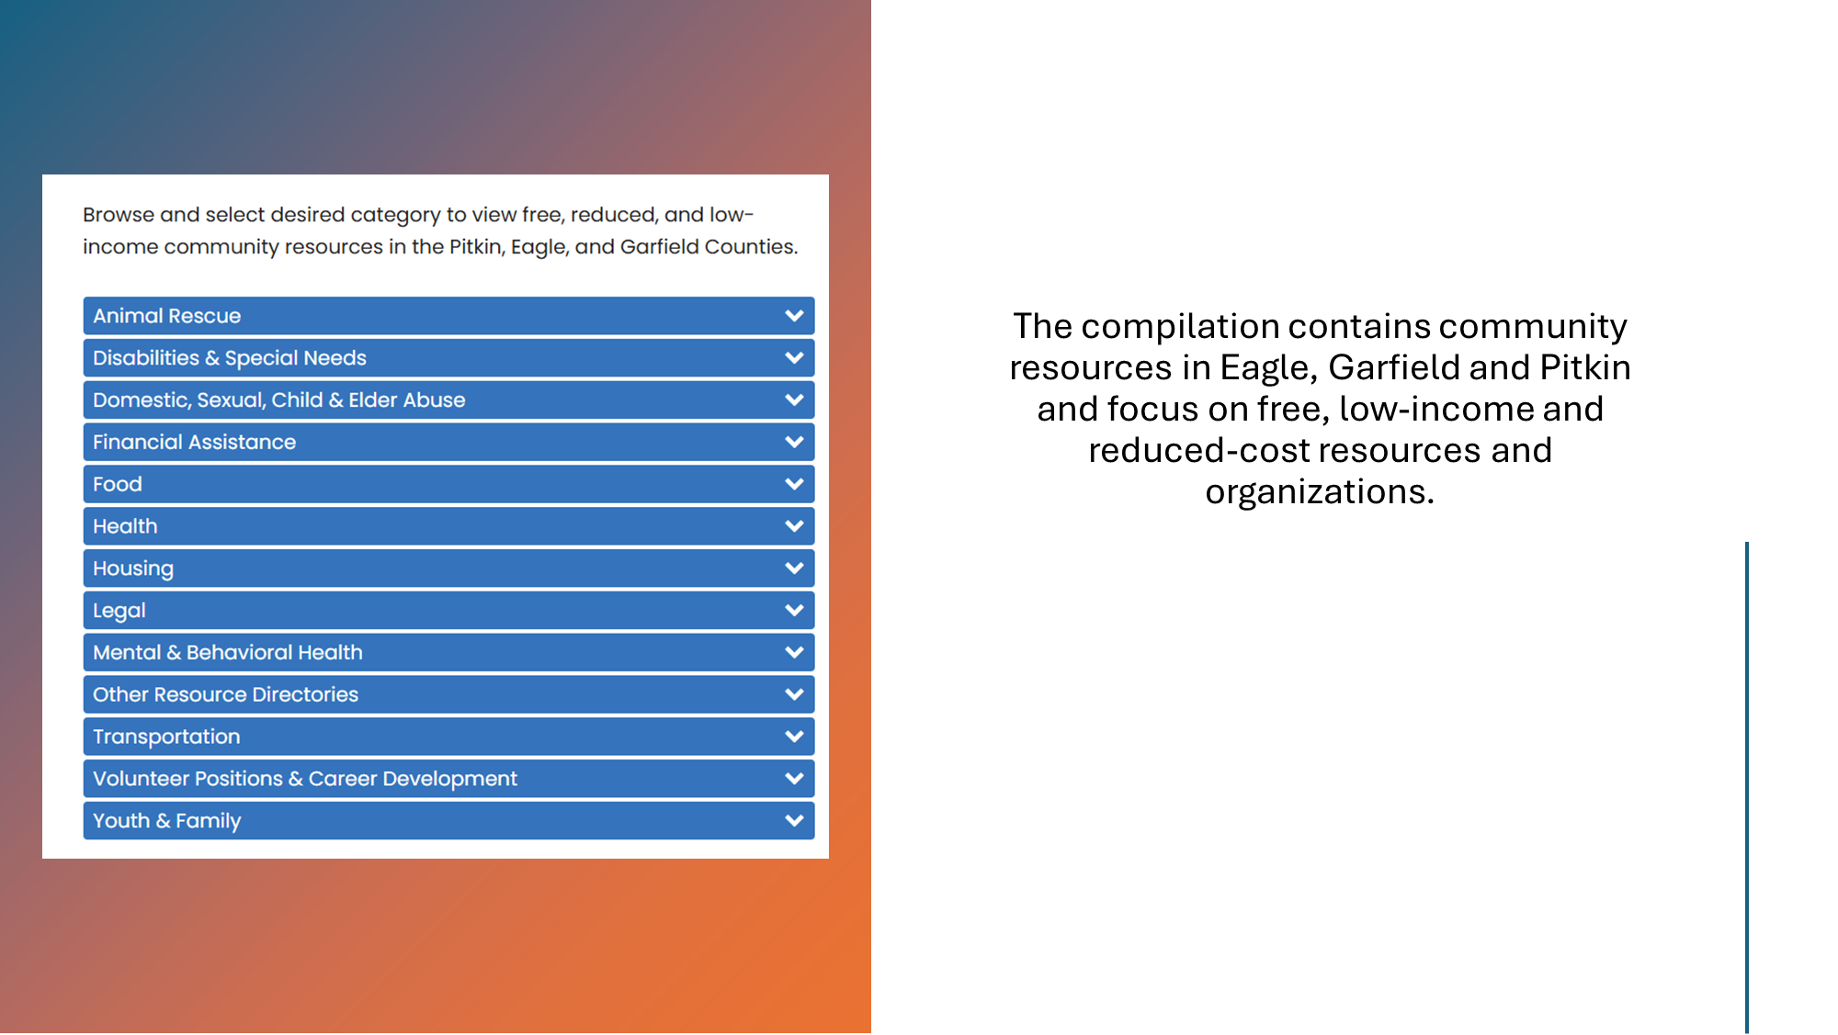

Slide 28
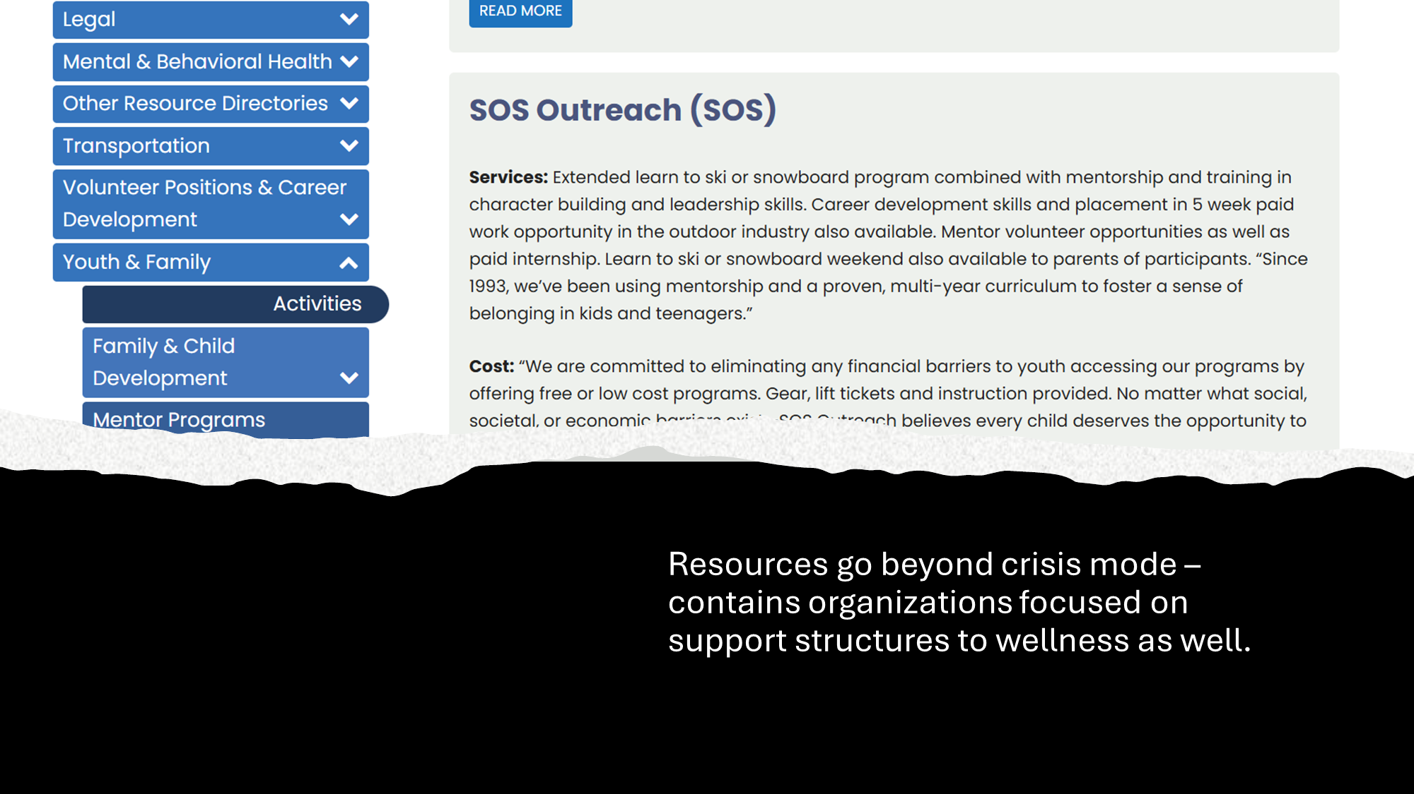

Slide 29
