Slide 1
2025 Findings

Slide 2
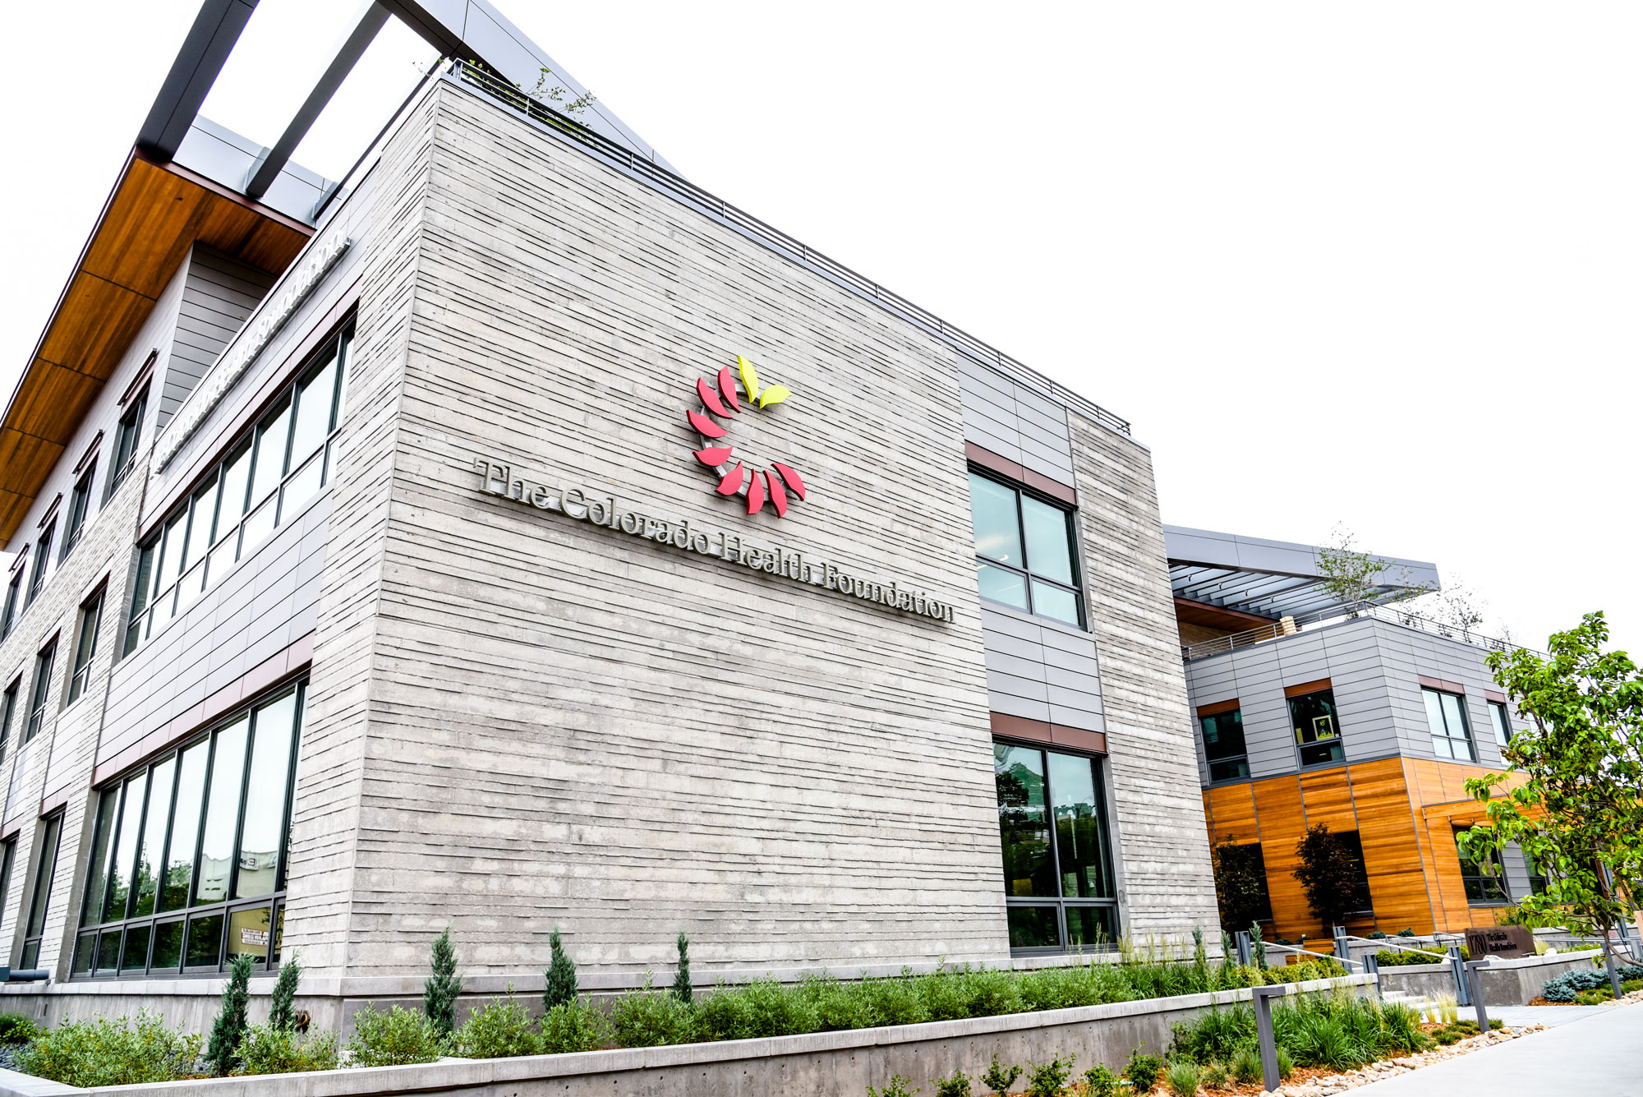
About The Colorado Health Foundation
CHF is a statewide non-profit, nonpartisan organization with a mission to improve the health and well-being of Coloradans.
We collaborate with organizations and communities across Colorado to break down barriers to achieving health and well-being.
We believe that health and well-being can be in reach for everyone.

Slide 3

About Pulse
Launched in 2020, it’s an annual poll that takes the pulse of Coloradans on a range of issues that impact health and well-being.
The Colorado Health Foundation partners with a bipartisan team of public opinion researchers to conduct the poll.
Pulse helps us hear from people beyond our usual circles, giving us a deeper understanding of what Coloradans are experiencing.
We survey more than 2,000 adults across the state, and share all the results with policymakers, community leaders and the media.
Interactive data dashboard available at copulsepoll.org
Notes:
As part of our commitment to racial justice, we oversample African Americans, Asian Americans and Pacific Islanders, and Native Americans to ensure their voices are represented in the data.

Slide 4





Survey Specifics and Methodology
(Not All Results Will Sum to 100% Due to Rounding)
Dates | April 19-May 18, 2025
Bipartisan Research Team | FM3 Research (D) and New Bridge Strategy (R)
Survey Type | Dual-mode Phone and Online Survey of Adult Coloradans
Research Population | 2,333 Coloradans including oversamples of Black/African-American, American Indian/Alaska Native , and Asian-American Coloradans, as well as residents of Morgan County
Margin of Sampling Error | ±3.07% at the 95% Confidence Level
Contact Methods
Data Collection Modes
Comparison Surveys | Pulse polls fielded in 2020-2024
Survey Languages | English and Spanish
Telephone
Calls
Email
Invitations
Text
Invitations
Telephone
Interviews
Online
Interviews

Slide 5
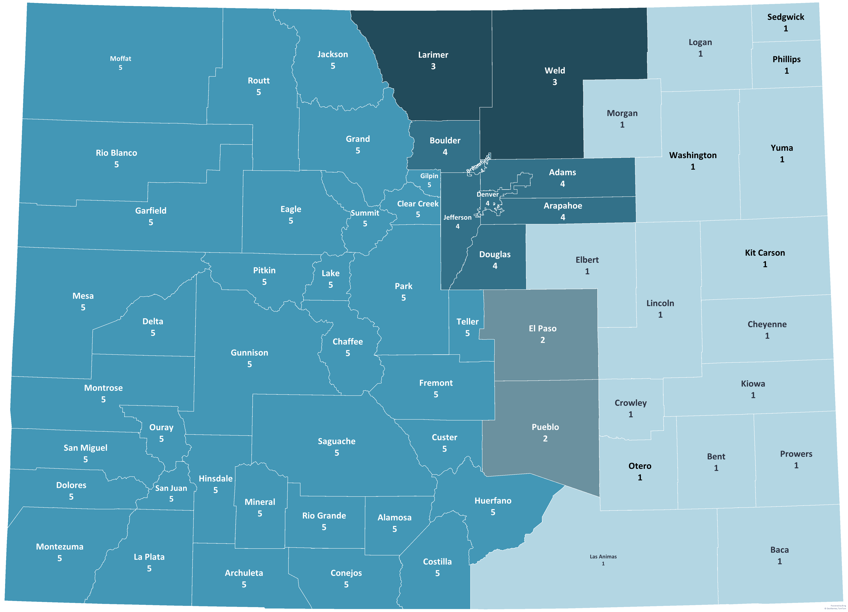
Colorado Region Map
 | Eastern Plains (1) | 2%
 | Colorado Springs (2) | 15%
 | Larimer Weld (3) | 12%
 | Denver Metro (4) | 56%
 | Western Slope (5) | 13%
Notes:
Really intended to give high level insights on how Coloradans are feeling - not as specific to regions as CHAS

Slide 6

Top Concerns for Coloradans
Notes:
MENTION TIMELINE and that this is a snapshot in time….

Slide 7
Coloradans value the state’s beauty, outdoor access, and a strong sense of community.
Q13. Next, other than the weather, which aspects of life in Colorado do you value most?
(Open-ended)

Slide 8
Concerns related to government and politics are volunteered as the most important issues facing Colorado.
Q14. And in a few words of your own, what is the most important issue facing Colorado right now?
(Open-ended)
Notes:
43% govt/politics on W. Slope

Slide 9
All four of the issues facing the state that are rated most serious relate to costs and housing.
Q15. Please consider the following issues that some people suggest are problems facing Colorado. Please indicate whether you think it is an extremely serious problem, a very serious problem, a somewhat serious problem, or not too serious a problem for residents of Colorado.
Ext./Very Ser. Prob.
89%
84%
75%
74%
65%
59%
58%
56%
55%
Split Sample

Slide 11





A significant proportion of Coloradans have experienced financial challenges in the last year.
Q23b. In the last 12 months, have you experienced any of the following?
(% Yes)
30% Postponed medical care | 33% Postponed dental care | 19% Had work hours cut back or wages reduced | 8% Been laid off | 12% Skipped meals because you couldn’t afford food
Notes:
REALLY DIFFERENT STORY FOR MEDICAID CLIENTS – INDICATORS ARE GETTING WORSE. SEE FACT SHEET
40% skipped meals – up from 37% in 2024
Nearly one-third are worried about affording enough food to feed themselves and their family.

Slide 12
Seven in ten are worried about affording to live in Colorado in the future.
Q24. Are you worried about whether you will be able to afford to live in Colorado in the future?
Total Worried 70%

Slide 13
About one-quarter of Coloradans report making a number of financial adjustments in order to afford housing.
Q31. In order to pay your rent or your mortgage in the last year, have you had to do any of the following:
*Avoided asking your landlord to address problems because you were afraid of having your rent increased or being evicted (n=422)
*Asked of Renters Only

Slide 14

Civic Engagement and Life in Colorado

Slide 15
Concern around government and politics has risen dramatically
Q14. In a few words of your own, what is the most important issue facing Colorado right now?
(Open-ended)
Issue | 2020 | 2021 | 2022 | 2023 | 2024 | 2025 | Difference (2024-2025)
Government/Politics | 19% | 14% | 15% | 13% | 11% | 32% | +21%
Economy/Jobs/Taxes | 13% | 12% | 9% | 7% | 4% | 7% | +3%
Water/Wildfires/Climate change/Environment | 13% | 20% | 21% | 16% | 5% | 8% | +3%
Social justice/Racism | 5% | 2% | 2% | 1% | 2% | 4% | +2%
Education | 4% | 3% | 3% | 3% | 2% | 3% | +1%
Traffic Congestion | 6% | 19% | 13% | 10% | 1% | 1% | 0%
Roads/Infrastructure | -- | 4% | -- | -- | 2% | 2% | 0%
Overpopulation/Growth/Overdevelopment | -- | 13% | -- | -- | 4% | 4% | 0%
Alcohol/Drug use/Opioid crisis | -- | -- | -- | -- | 2% | 2% | 0%
Healthcare/Health insurance/Health | 8% | 4% | 4% | 3% | 5% | 3% | -2%
Public safety/Crime | 4% | 5% | 10% | 12% | 7% | 4% | -3%
Homelessness | -- | 6% | 7% | 10% | 10% | 6% | -4%
˚Immigration/Crisis at the border/Border security/Deportations | -- | 1% | 2% | 1% | 13% | 7% | -6%
Cost of living/Inflation | 10% | 7% | 20% | 16% | 19% | 13% | -6%
Housing affordability | -- | 10% | 17% | 15% | 17% | 10% | -7%
Immigration/Need for reform/Path to citizenship/Better treatment | -- | -- | -- | -- | 10% | 1% | -9%
*Wording Slightly Different

Slide 16
Volunteering for social causes is seen as the most impactful way of improving their community.
Q16. Here is a list of ways Coloradans can improve their community. Please indicate how effective you think this kind of activity is at improving your community, using a scale of one to seven, where “one” means very ineffective and “seven” means very effective. You may choose any number from one to seven.
Mean Score
4.7
3.9
3.8
3.8
3.6
3.5
3.1
*Split Sample
Notes:
We continue to see most Coloradans saying they have experienced mental health strain in the past year.
Coloradans report that politics has contributed the most to mental health strain – more than even financial issues.

Slide 17
Urban residents are more likely to see volunteering as effective; suburban residents see more value in public expressions of support for causes.
Q16. Here is a list of ways Coloradans can improve their community. Please indicate how effective you think this kind of activity is at improving your community, using a scale of one to seven, where “one” means very ineffective and “seven” means very effective. You may choose any number from one to seven.
(% 6-7 (Very Effective))
Activity | All | Urbanicity
 |  | Urban | Suburban | Rural
Volunteering with organizations working on the social causes you care about | 37% | 42% | 35% | 27%
Communicating directly with policymakers | 24% | 25% | 27% | 21%
Speaking at public meetings of local government | 21% | 21% | 23% | 16%
*Publicly expressing your support for social causes | 20% | 16% | 31% | 14%
Stating your own opinion about social or political issues openly, even in settings where others may have opposing views | 17% | 17% | 19% | 11%
Publicly expressing your support for political candidates | 14% | 13% | 18% | 9%
*Publicly expressing your support for social causes on social media | 12% | 13% | 10% | 12%
*Split Sample

Slide 18

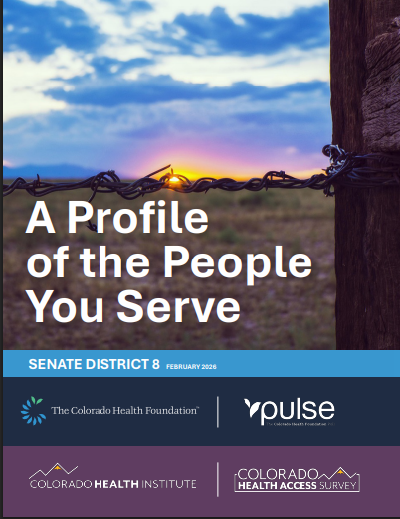
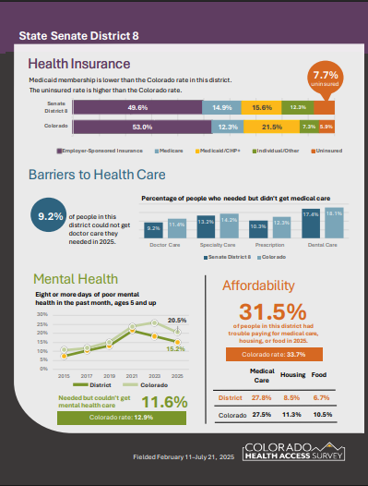
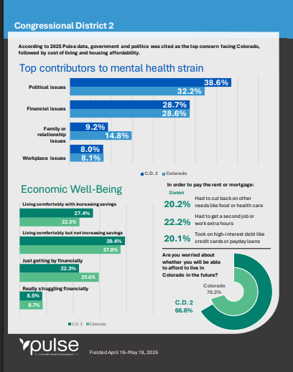
New Resource: District Profiles

Slide 19
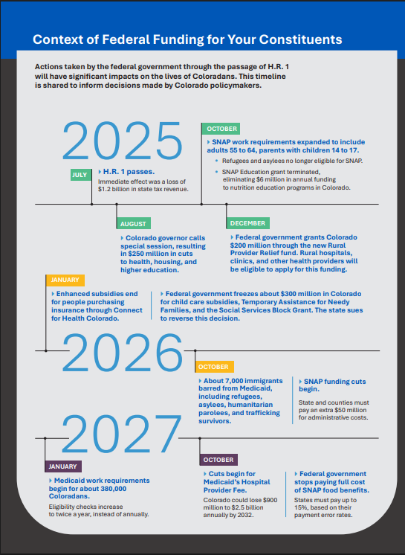
Legislative and Congressional District Profiles: https://coloradohealth.org/legislative-district-profiles
Find your legislator/district: https://leg.colorado.gov/find-my-legislator
Pulse: www.copulsepoll.org
CHAS: colo.health/CHAS

Slide 20



Engage with future CO Leaders
Candidate Forums:
Congressional District 8 Democratic Candidate Forum
The University of Northern Colorado
May 28, 2026 at 6 p.m.
Gubernatorial Forum
June 13 (details being finalized)
Attorney General Forum
June 9 or 10 (details being finalized)
Fall Forums (dates TBD)
Livestreamed events. Simultaneous translation
Submit questions! Host a watch party.

Slide 21
CONTACT US
www.copulsepoll.org
ALEXIS WEIGHTMAN
Senior Govt Affairs Manager
Colorado Health Foundation
aweightman@coloradohealth.org
KATIE PESHEK
Senior Communications Officer
Colorado Health Foundation
kpeshek@coloradohealth.org

