Slide 1
PCORI Findings Report: “Building Capacity to Address Latino Child Overweight Disparities in Rural Communities”
Mari Plaza Munet
Lisa Ross DeCamp
Jenifer Valdez Vormezeele

Slide 2
Acknowledgement and Disclaimer
This project was funded through a Patient-Centered Outcomes Research Institute® (PCORI ®) Eugene Washington PCORI Engagement Award (EACB-30311).
The views, statements, and opinions presented in this presentation are solely the responsibility of the author(s) and do not necessarily represent the views of the Patient-Centered Outcomes Research Institute® (PCORI ®), its Board of Governors or Methodology Committee.

Slide 3
Engagement Award Overview
University of Colorado researchers partnered with West Mountain Regional Health Alliance to conduct project
Conducted interviews with local leaders and parents to understand local strengths and challenges in promoting healthy weight
Formed Partner Network with members from Garfield and Eagle Counties to determine future program and research priorities
Plan to implement priority program and evaluate it using future funding

Slide 4
PCORI Project Team
West Mountain Regional Health Alliance
Mari + Namrata
University of Colorado
Lisa and Jenny
Project Facilitators
Partner Network of Community organization and parent leaders
PCORI Project Team
Brisa | McKenzie | Cecilia
Cynthia | Inés | Soira
Anabel | Abel | Isabel
Sofia | Luz | Christine
Julieta
Partner Network

Slide 5
Key interview findings: Local Contributors to Childhood Overweight
Economic Barriers:
High cost of healthy food; low incomes; expensive housing
Food Access & Habits:
Cheaper junk food; limited school/summer meal access
Limited time, nutrition knowledge, and teens preference of fast food
Limited Physical Activity Opportunities:
Few affordable recreation options; long winters; safety concerns; high screen time
Cultural Influences:
High‑calorie traditional foods, large portions, snacking culture, fast‑paced eating
Other Factors:
Stress, trauma, poor mental health, emotional eating

Slide 6
Key interview findings: Local Opportunities & Challenges for Promoting Healthy Weight
Local Programs:
Limited in‑person access, mostly virtual programs
Strict eligibility for federal/county supports
Schools and Community Member Efforts:
Schools provide minimal nutrition education and PE classes
Cooking classes popular
Community-sponsored health events well‑attended
Clinics:
Few affordable options and specialty care far away
Culturally misaligned clinics
Weak clinic–county coordination reduces referrals to nutrition programs

Slide 7
OVERVIEW OF PARTNER NETWORK ACTIVITIES

Slide 8
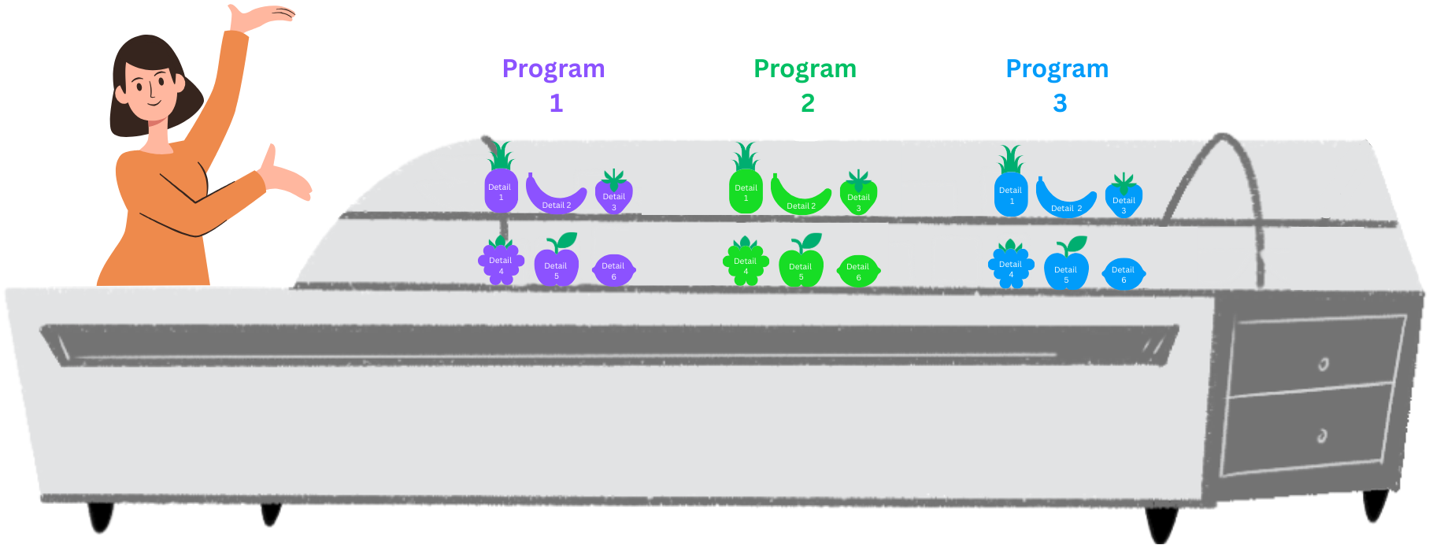
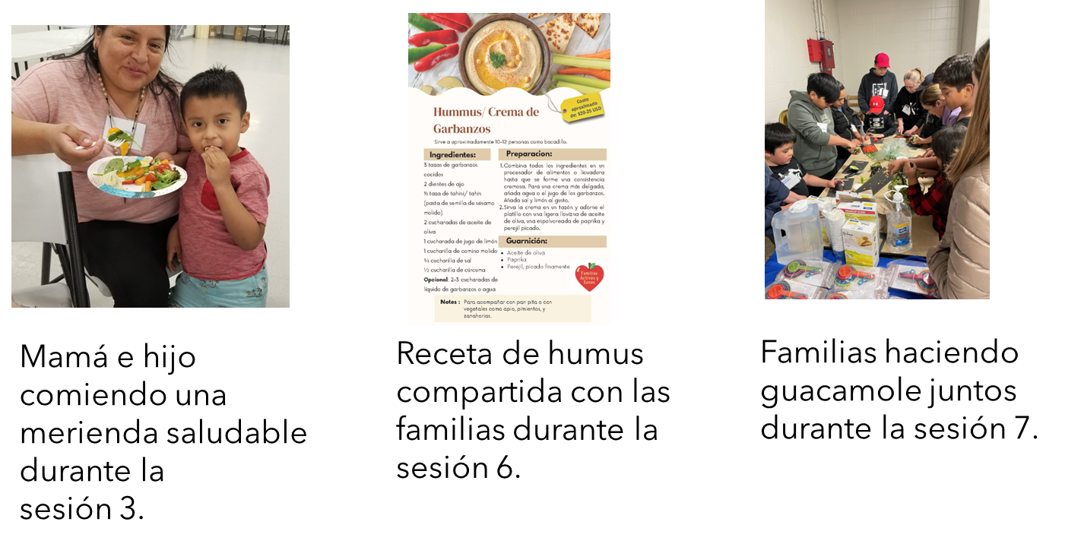
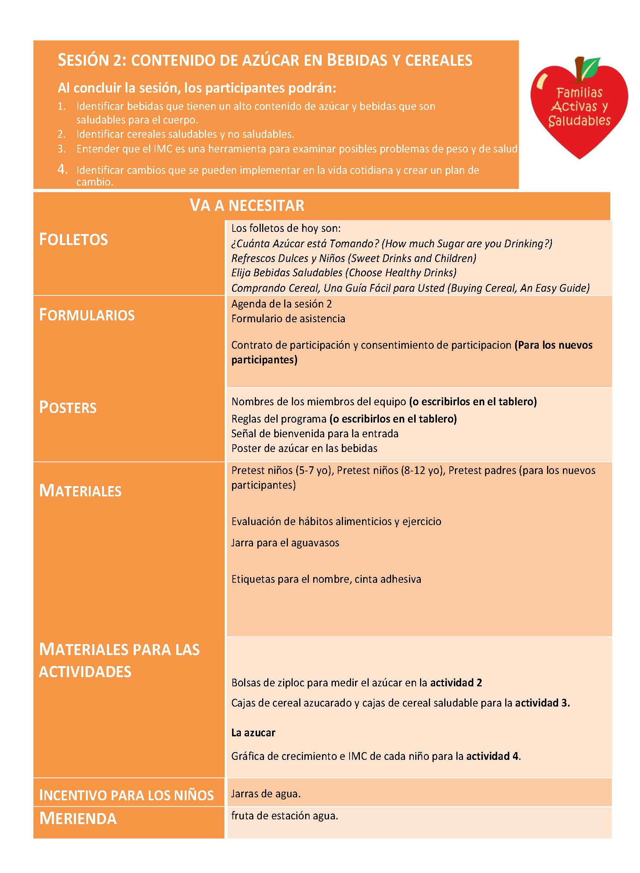
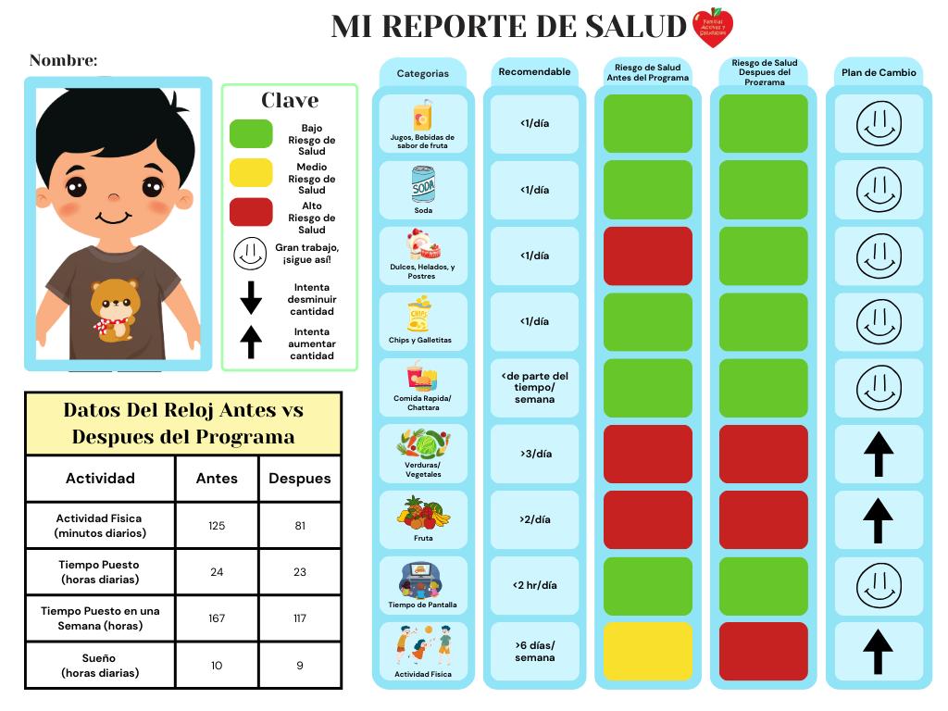
Discussed Community Program Examples
Active and Healthy Families

Slide 9

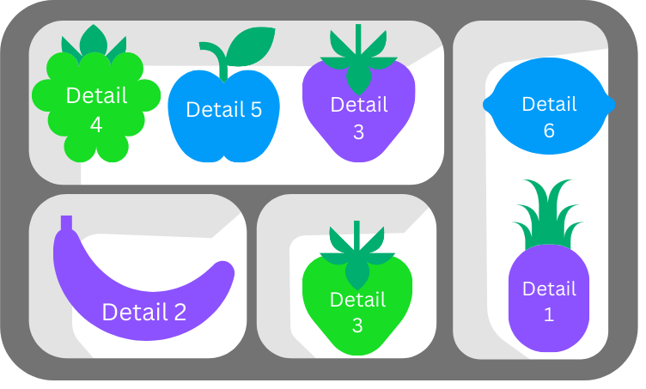
Compared Programs to Identify Priority Programs
Development of 1-2 possible programs for the Latino community in Eagle and Garfield County

Slide 10
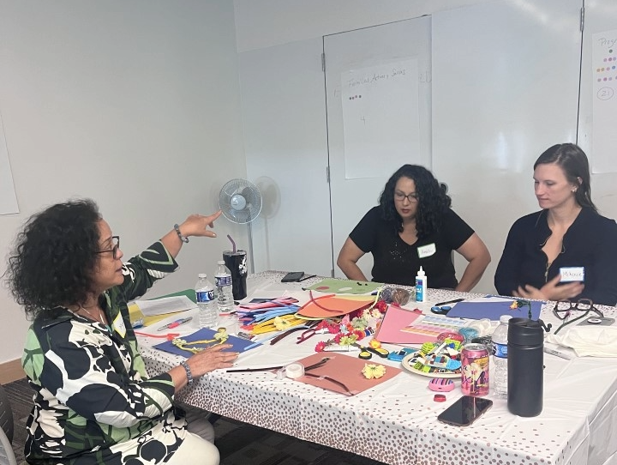
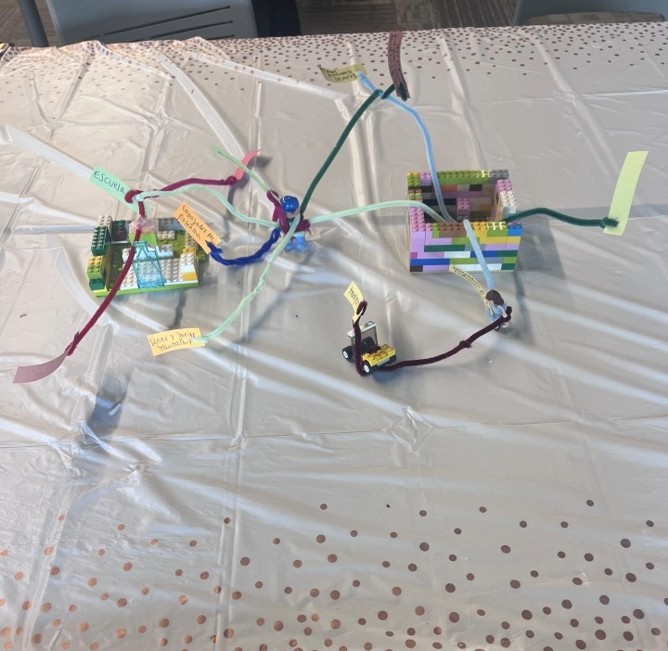
Method of Engagement: Design Thinking
After review of potential interventions to promote healthy weight and capacity building in patient-centered CER held 4-hour in person design thinking workshop
Design thinking uses a series of activities to identify priorities and design creative solutions
Notes:
Highlight that this was the method we used to prioritize

Slide 11
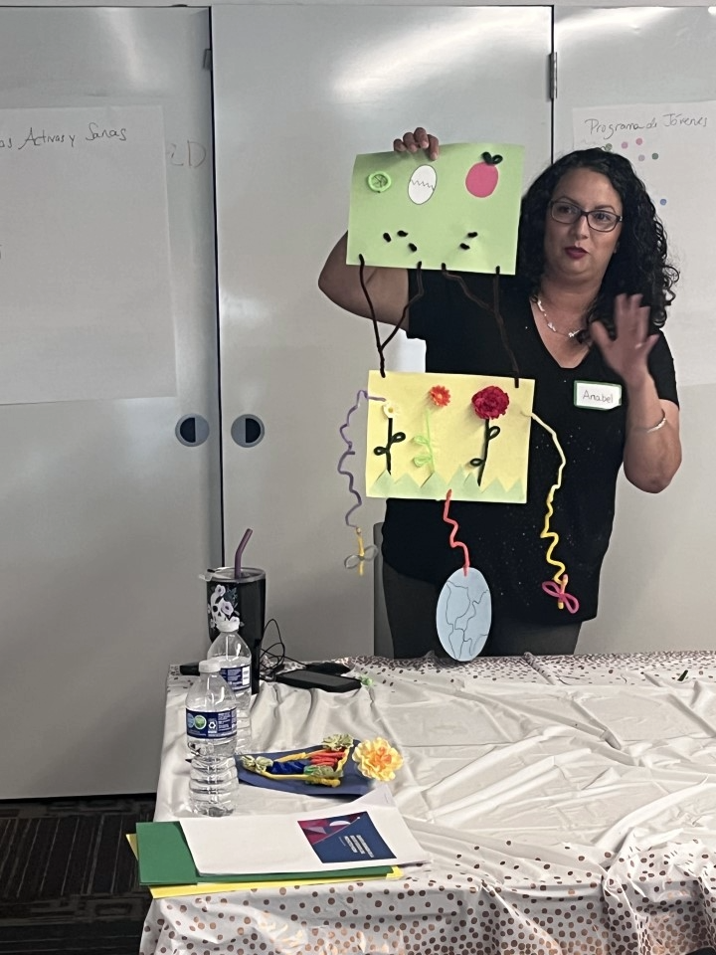
Method of Engagement: Design Thinking
Resulted in clear preference for a Youth Health Ambassador Program that provides education on nutrition, physical activity and food justice and supports participants to access healthy foods
Emphasis on an integrative approach to promote healthy weight across youth, family and community factors
Notes:
Highlight that this was the method we used to prioritize

Slide 12
Community Dissemination to Youth
Purpose: Gather youth feedback on the proposed Youth Ambassador Program and future implementation and evaluation
Meeting Summary
Partnered with established youth-serving organizations for recruitment
  Eagle County: After-school youth center offering health, academic, social, and emotional programming
    Meeting: April 16, 2026 (9 youth participants)
  Garfield County: : Youth mentoring program
    Meeting: April 18, 2026 (3 youth participants)
Overall Findings
Youth in both counties responded positively to the program concept and research approach.
Distinct county contexts influenced priorities, preferences, and perceived barriers.
Key Takeaway: Future implementation should be tailored to county-specific needs and realities.

Slide 13
Differences in Youth Perspectives
Topic | Eagle County | Garfield County
Overall Focus | Social connection, enjoyment, peer engagement | Practical challenges, access, affordability, competing responsibilities
Nutrition | Learning healthy foods and where to find them | Cost, taste, obesity, diabetes prevention
Cooking Skills | Creative, gourmet, vegan/vegetarian, cultural foods | Affordable meals and practical life skills
Learning Format | Visual materials, limited text | In-person learning and trusted information sources
Physical Activity | Fun, movement, social interaction | Cost barriers, access, fear of judgment, embarrassment
Key Theme: Eagle youth were primarily experience-focused, while Garfield youth were more resource- and barrier-focused.

Slide 14
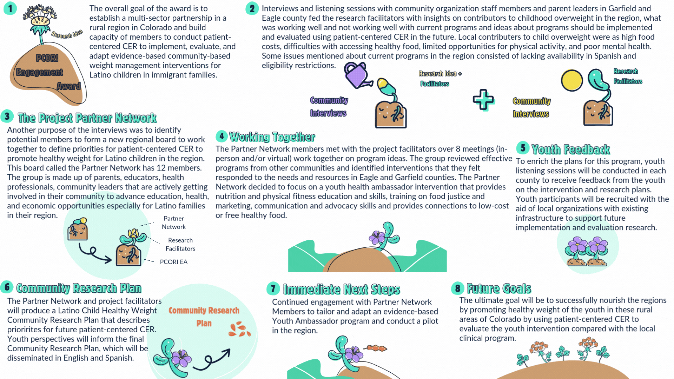
Project Graphical Summary

Slide 15
Thank you to everyone who participated in this project and/or helped make project activities possible!
Questions? Comments?

