Slide 1
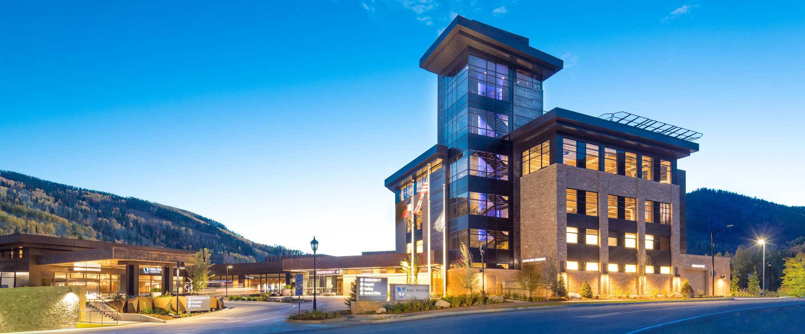

Slide 2
Vail Health's Journey with SDoH Screening
Alison Nieves, Director Case Management

Slide 3
Progress with SDoH Screening
Continuous Quality Improvement
Multiple PDSA Cycles
People, Process and Technology

Slide 4
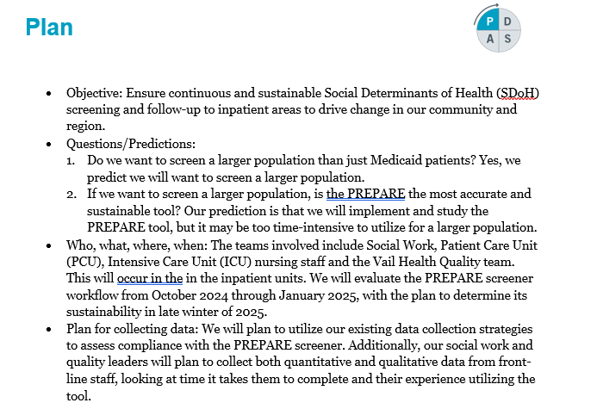
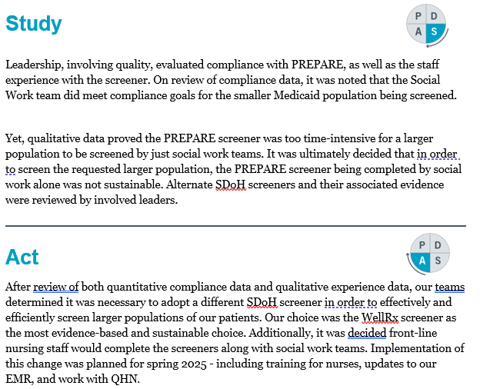
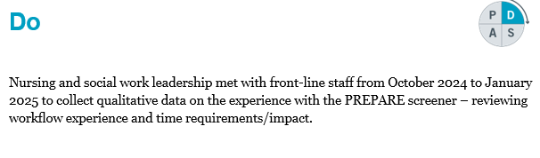
PY4Q2 (Oct24-Mar25) --SDoH

Slide 5
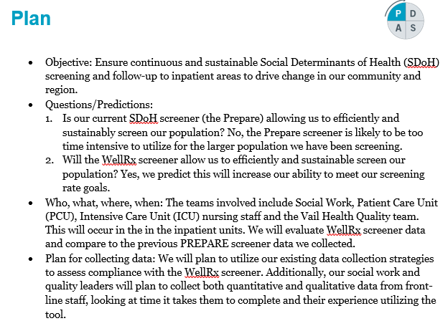
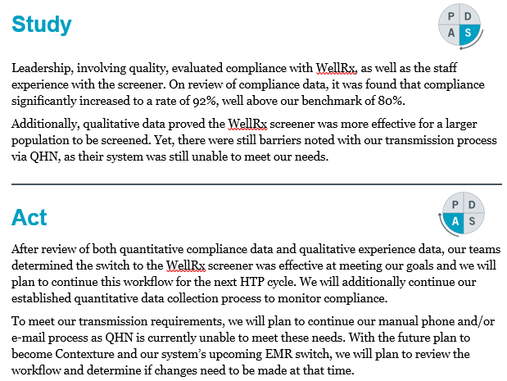
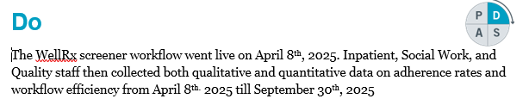
PY4Q4 (Apr25-Sept25) --SDoH

Slide 6
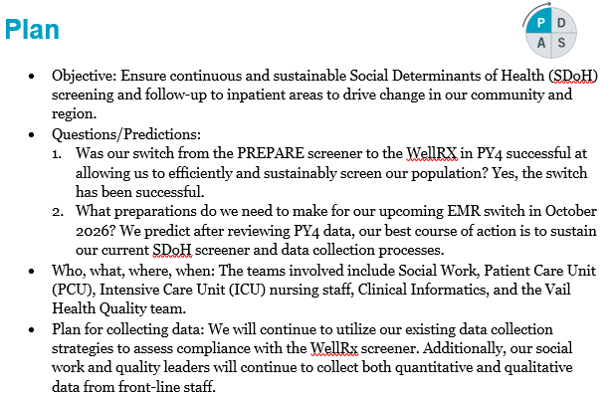
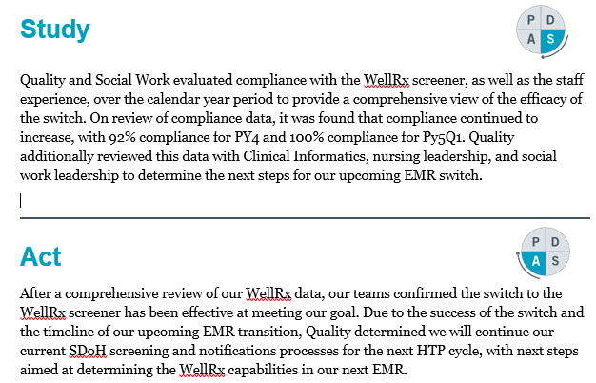
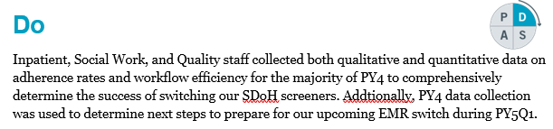
PY5Q2 (Oct25-Mar26) --SDoH

Slide 7
So What Now What?
Increased compliance with screening means that we are intervening and providing resources to more patients who have needs
  This in turn will drive improved outcomes for those patients
Increased compliance with screening allows for more data/information to inform larger hospital and community wide efforts related to SDoH
  Data shows Housing and Transportation as the biggest needs for our patient population
Ongoing partnership and efforts across Eagle County related to these needs and others
  In particular Vail Health has supported the Community Market (Food Bank) by providing space on our Community Health Campus

