Slide 1

Hospital Transformation Program
Grand River Health

Slide 2
Inpatient Follow-up
Appointment made before Discharge

Slide 3
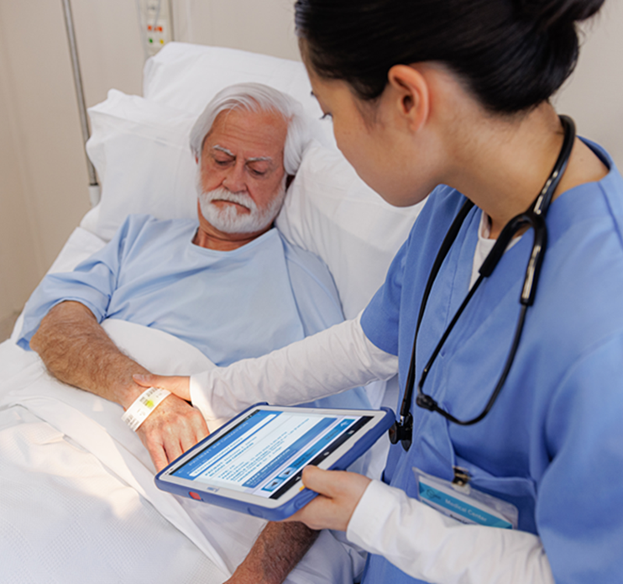
IP Follow-up Planning
Unit Secretary meets with Patient for Primary Care/Specialty connection
GRH / QHN / RMHP – Electronic submittal to RAE
Weekends – Appt made on Friday or Monday morning

Slide 5
Emergency Department Follow-up
Patient attends Appointment Post Discharge

Slide 6
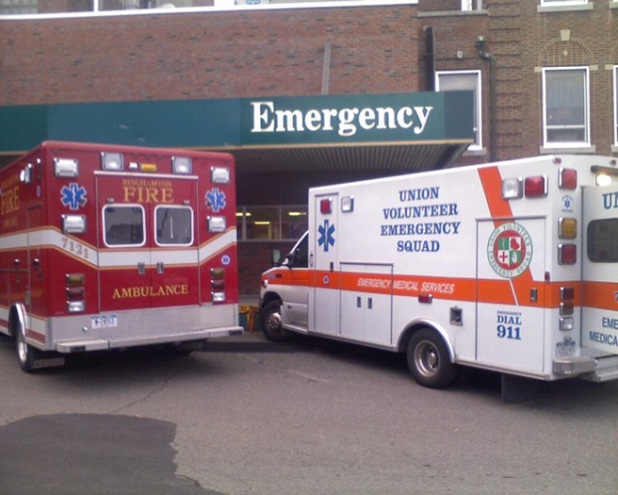
ED Follow-up Planning
Patients must ATTEND follow-up appt
Continuous Improvement
  Audits for compliance with process
  Many PDSA cycles with this measure
  Currently trying to get appointments made prior to leaving ED
Challenges
  Patient dependent
  Processes challenging

Slide 8
Alternatives to opioids
(ALTO)
Decrease Opioids / Increase Alternatives

Slide 9
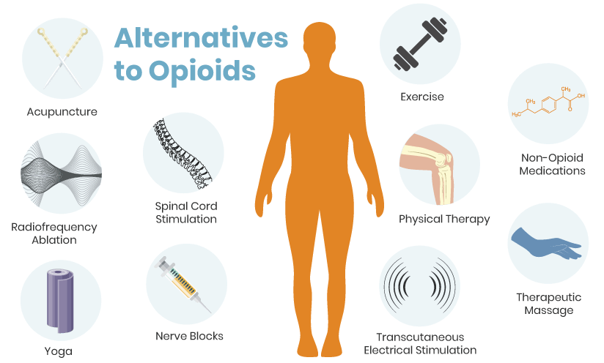
Alternatives to Opioids
CHA aggregates data/ Average Performance
Increase ALTO’s and Decrease Opioids
PT in ED
TENS units
Trigger Point Injections
Challenges: Stigma bias, patients accepting alternatives
Notes:
© Copyright Showeet.com – Free PowerPoint Templates

Slide 10
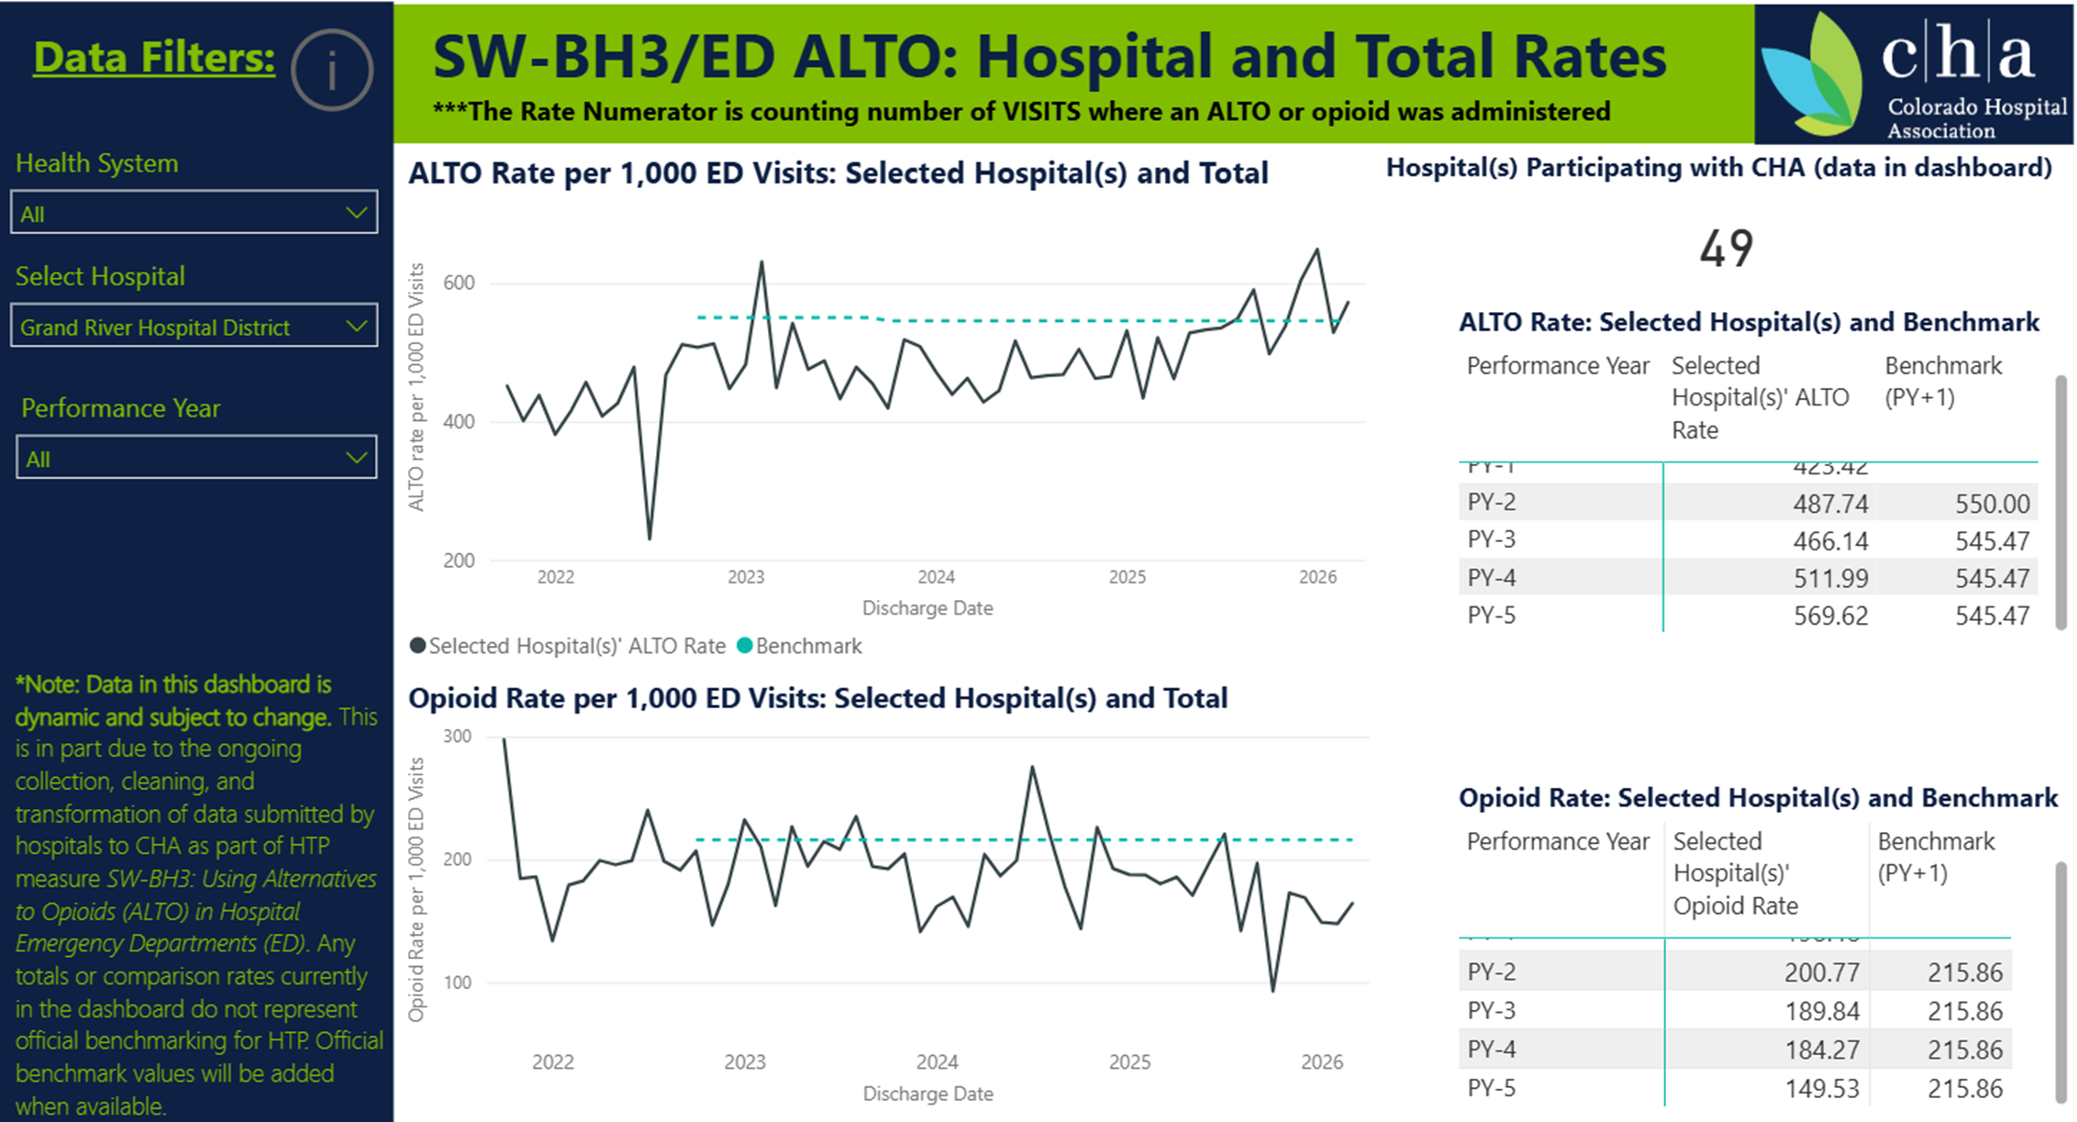

Slide 11
Wellness Visits
Increase Annual Wellness Visits

Slide 12
Well Visits
Marketing
  Radio / Podcasts
  Health Fairs
  Inpatient Education
Child Well Visits
Appointments made at Discharge
Reminders

Slide 13
Specialty Care
Increase Access to Specialty Care

Slide 14
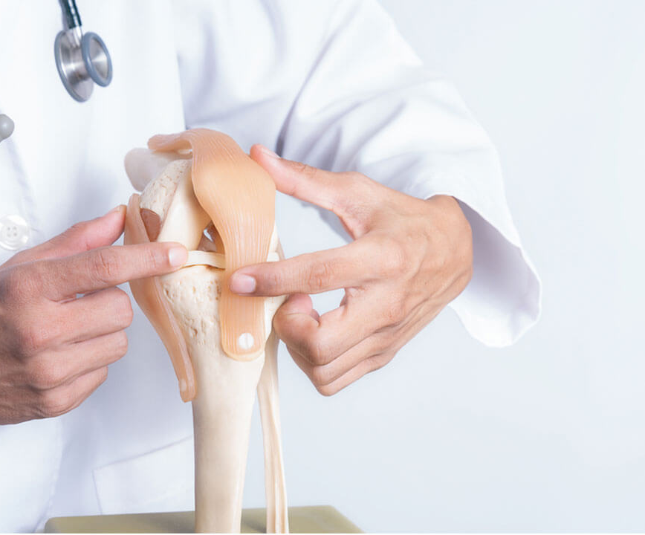
Increase Specialty Care
Orthopedics
Gynecology
Mental Health
Rehab therapies –PT / OT / ST
CardioPulmonary w/ Rehab
Ears Nose & Throat
Dermatology
General Surgery
Metabolic
Changing Lifestyles
Gastroenterology
Infusion/Chemo
Ophthalmology
Addiction Medicine
Valley View Partnership
Cardiology
Urology
Notes:
© Copyright Showeet.com – Free PowerPoint Templates

Slide 16
Social Determinants of health
Screen all Medicaid for SDOH & send to RAE

Slide 18
SDOH
Food Highest need
Housing 2nd
Transportation 3rd
Decrease in Medicaid enrollees

Slide 19
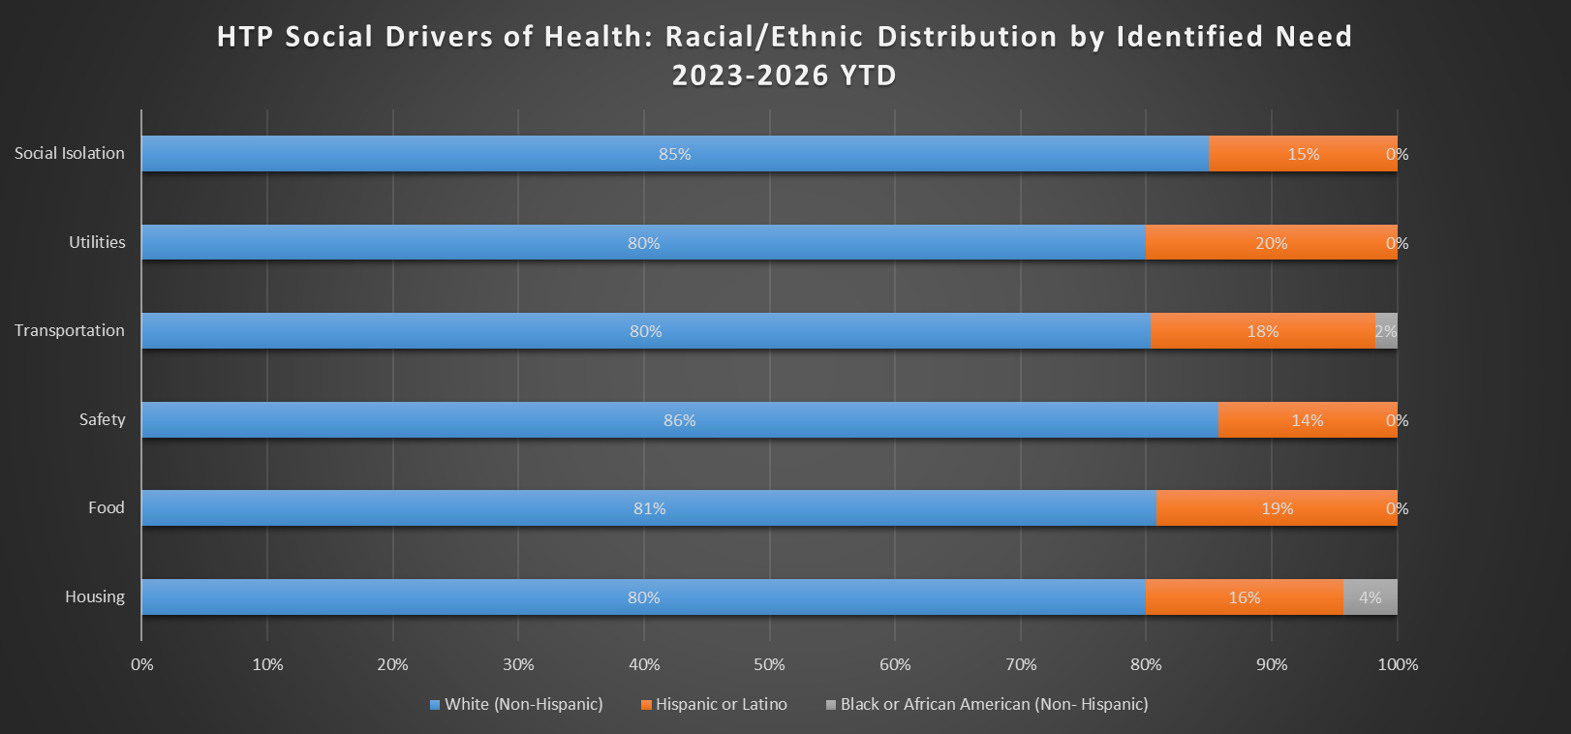
Needs based by Race/Ethnicity

Slide 20
SDOH Evolution
(Successes!)
1st Annual Community Resource Fair
GRH/Community Partners
2019
GRH Implements AHCM Screener
RMHP/WMRHA
2020
Community Resource Network
QHN
Food Bag Program
Lift-Up
2023
Clinics SDOH Screen & EHR Incorporation
2022
2022

Slide 21

Questions?

